Slide 1

PGP In Project Engineering Capstone Project
Team 8
03-Dec-2023

Slide 2
Plan
Team introduction
Capstone Project overview
Capstone Project solution design & solution implementation
Challenges & errors encountered during solution design
Learnings & enhancements
What extra has been implemented in the Capstone Project

Slide 3

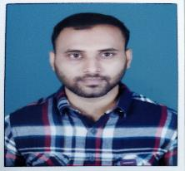
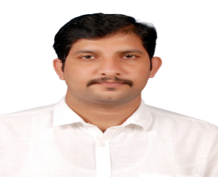
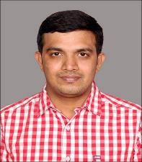
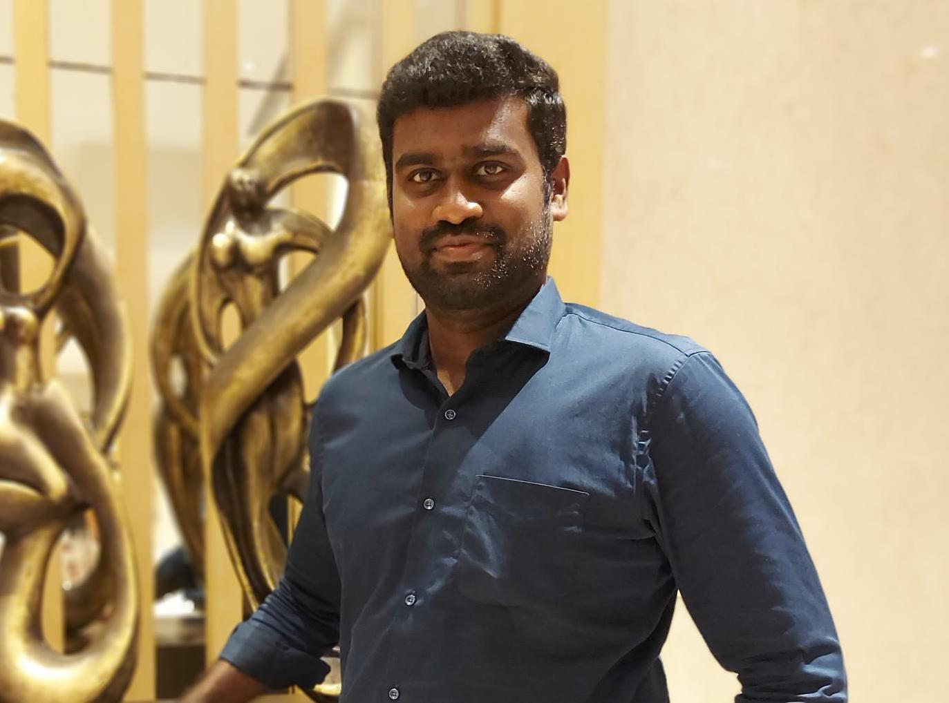

Team8 Introduction
Sathish PH
Scrum Master
Backend Developer
User Stories : Designed a Robust Order history report for end user in Ecommerce Application
Narayanan A
Backend Developer
User Stories: Designed an order Tracking the orders seamless with real time tracking
Shyam Sundar R
Backend Developer
User Stories: Designed an order Notification for the order status change to end user on timely manner
Sree Hari B
Backend Developer
User Stories: Designed an order Return for the order and initiate the return process for the order
Nelson Prabhu
Frontend Developer
User Stories: Designed a front-end react application for the order history , support and returns function for end user
Sundarrajan C
Backend Developer
User Stories: Designed support ticket for the order and end user can contact support team.

Slide 4
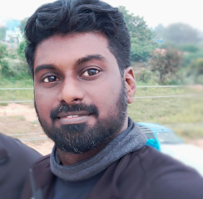
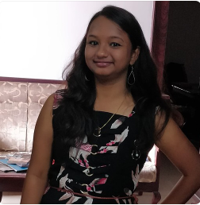

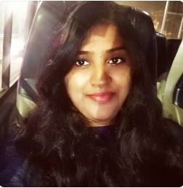


Team9 Introduction
Rajesh Ramakrishnan
Scrum Master
Backend Developer
Efforts: Designed and created code for product DB retrieval and new addition, exception handling, docker, class, Junit testing, log file dependency-sequence-class diagram , web hosting, jenkins and cloud VMs setup.
Swetha Gothandaraman
Backend Developer
Efforts: created backend code for new rating, Splunk log, exception handling, Sonarlint, code correction, junit testing, code practice, vulnerability fixes, Accuator, and presentation.
Sridhar Thiruppathi
Backend Developer
Efforts: Created temp DB, logics for handling user token, redirect , GitWorkflow, response codes, error corrections, temp rating services, junit testing, backend end integration, authentication
Yogapriya Rajavelu
Backend Developer
Efforts Presentation , Flow diagram, business logics, delete, update operation in java coding for backend, post & Get request logics, Data moderation for admin.
Prasath Elumalai
Frontend Developer
Efforts : Combined with Linga and created the front-end react application for Customer rating section and use case diagram for front end and presentation.
Lingaraj MK
Frontend Developer(shared from Team 6)
Efforts : Key player who created the front-end react application for Customer rating , front end integration, Admin Page, rejected/approve logics and image handling.

Slide 5
Order Management and Customer Support System(OMCSS)
Team-8 OMCSS
TEAM-4 CART
TEAM-7 TRACKER
TEAM-6 ORDER
Features:
Access order history
Track current orders
Receive timely notifications
Initiate support tickets
Process returns
Dependency and Collaboration:
Dependencies on Cart, Order, and Tracker Services.
Collaborating with Team-4, Team-6, and Team-7.
5

Slide 6
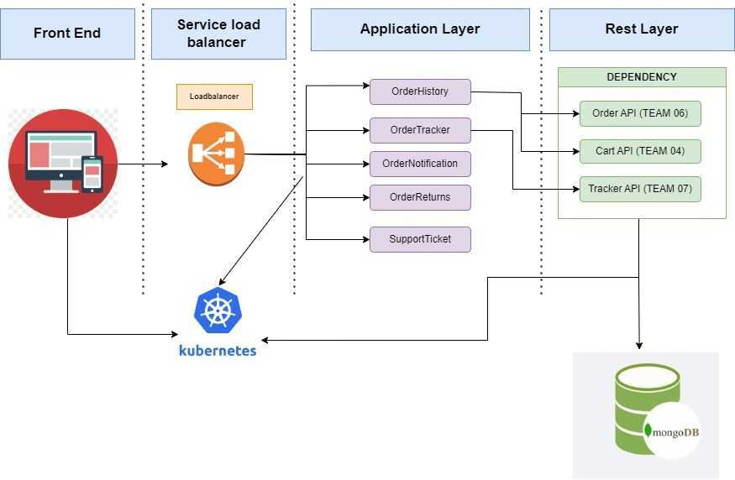
Microservice Architecture Diagram

Slide 7



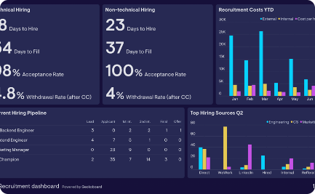
Design
User Experience
Customer Feedback
Admin Dashboard
Provide an intuitive rating system with 5-star appearances and straightforward mechanism.
Provide a section to write a review, feedback or ask for help.
A dashboard to monitor reviews, approve & Reject.

Slide 8
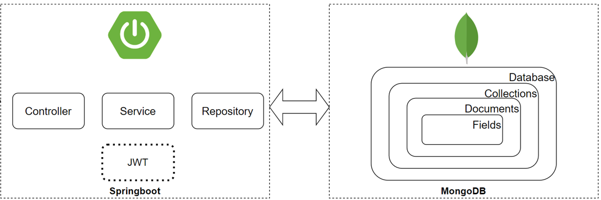
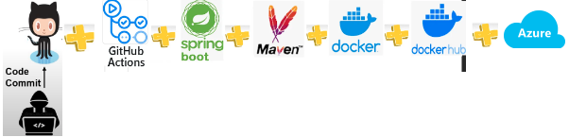
Capstone Project design
System Architecture
Product | Link
GitHub Repository | Team09_BackendCode
DockerHub Image | danicoolbug/cusreviewhub
CI/CD- GitAction | Project CICD Flow
Azure VM (Group 4) | Group: team9-vm, Public IP: 40.117.126.242, DNS: customerrating.eastus.cloudapp.azure.com
Postman Collection | Team9 Postman Collection in git- Team09_BackendCode
Back End: Spring Boot framework + Java
Database : MongoDB Atlas
Logging: Sl4J Logger
Container: Docker images
CICD: Git-Action
Hosted Cloud: Azure VM
FrontEnd: JavaScript

Slide 9
REST API Documentation
TYPE | Description | HTTP Method | API Endpoint
MAIN USECASE’s | Logged in customers can write review comments and ratings for products(Saves in temporary DB collection for Admin Approval and mail the status to customer) | POST | http://customerrating.eastus.cloudapp.azure.com:9801/api/approval/10/comment
 | Retrieve Customer Ratings submitted for Admin Approvals for all products | GET | http://customerrating.eastus.cloudapp.azure.com:9801/api/approval/
 | Once Admin Approves in frontend, Customer rating is moved to the main product collection if not approved email is triggered to customer with reason. | POST | http://customerrating.eastus.cloudapp.azure.com:9801/api/product/17/comments
 | Delete an existing Rating from Temp Collection | DELETE | http://customerrating.eastus.cloudapp.azure.com:9801/api/approval/delete/34/Muthu
 | Retrieve existing Customer Rating & Comment of a specific product in ecommerce website | GET | http://customerrating.eastus.cloudapp.azure.com:9801/api/product/25/by-ratings/3
EXCEPTIONS | API Request with incorrect Product ID | GET | http://customerrating.eastus.cloudapp.azure.com:9801/api/product/560/by-ratings/3
 | API Request with incorrect Star Rating | GET | http://customerrating.eastus.cloudapp.azure.com:9801/api/product/5/by-ratings/10123
 | API Adding Rating to main DB without user email address | POST | http://customerrating.eastus.cloudapp.azure.com:9801/api/product/17/comments
 | API Adding Rating to main DB without Admin Approval | POST | http://customerrating.eastus.cloudapp.azure.com:9801/api/product/17/comments
 | User can update the Rating & Comment when until it is approved and will only be overriding avoiding duplicates. | POST | http://customerrating.eastus.cloudapp.azure.com:9801/api/product/17/comments

Slide 10
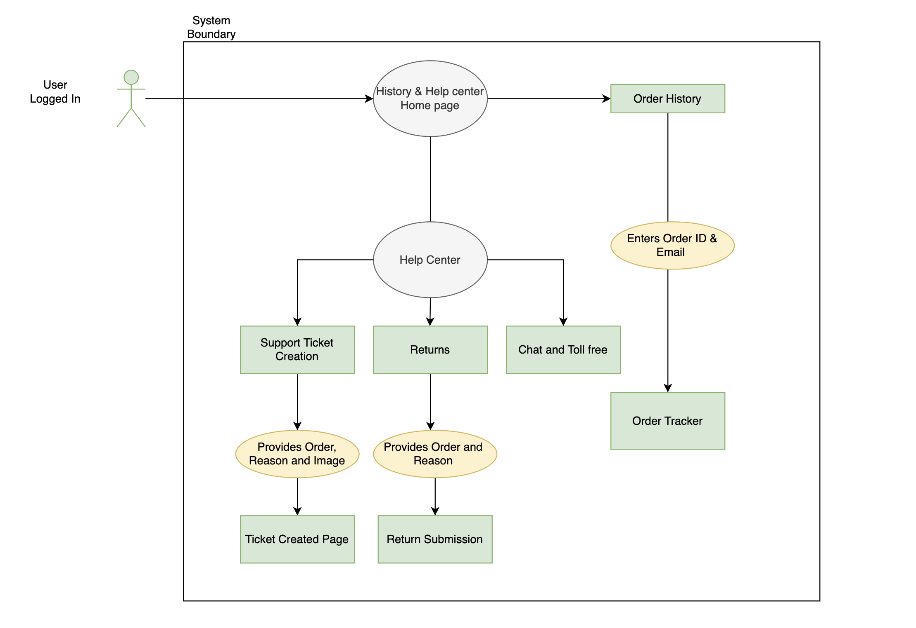
Use Case Diagram

Slide 11
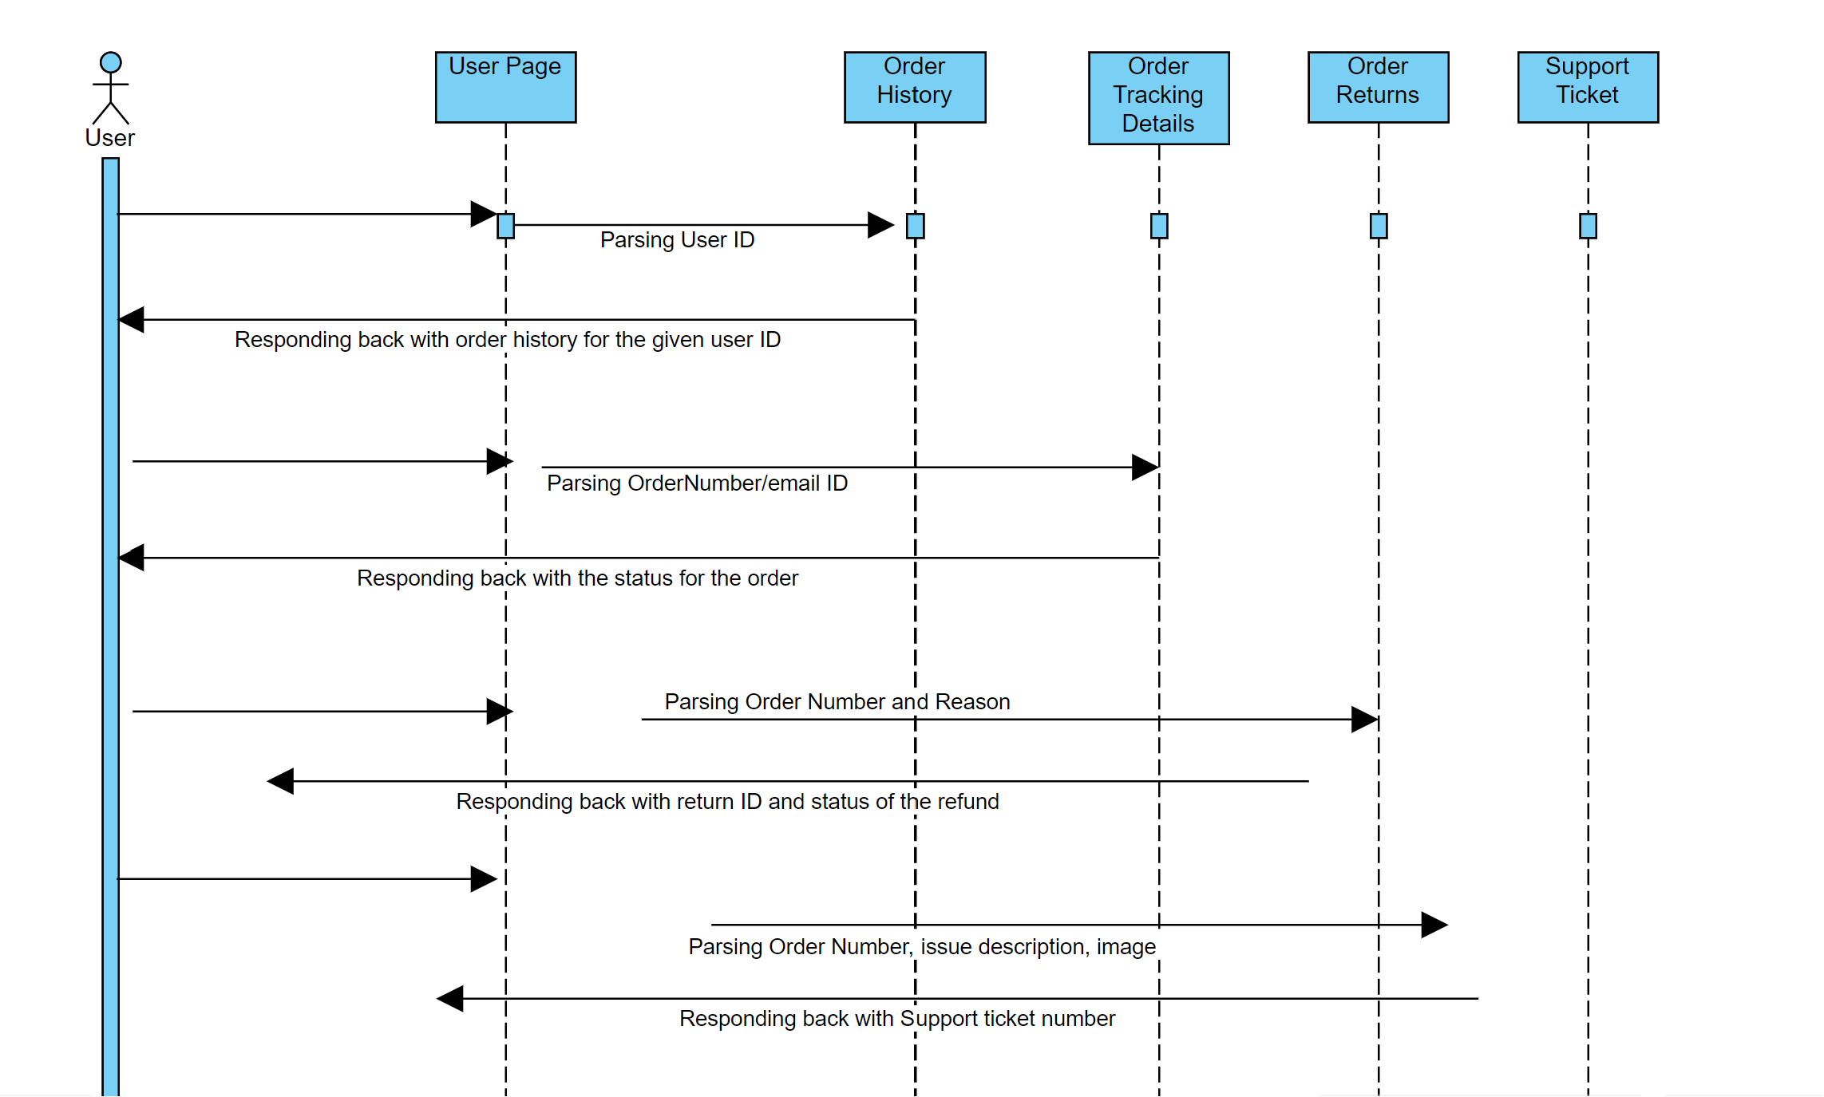
Sequence Diagram

Slide 12
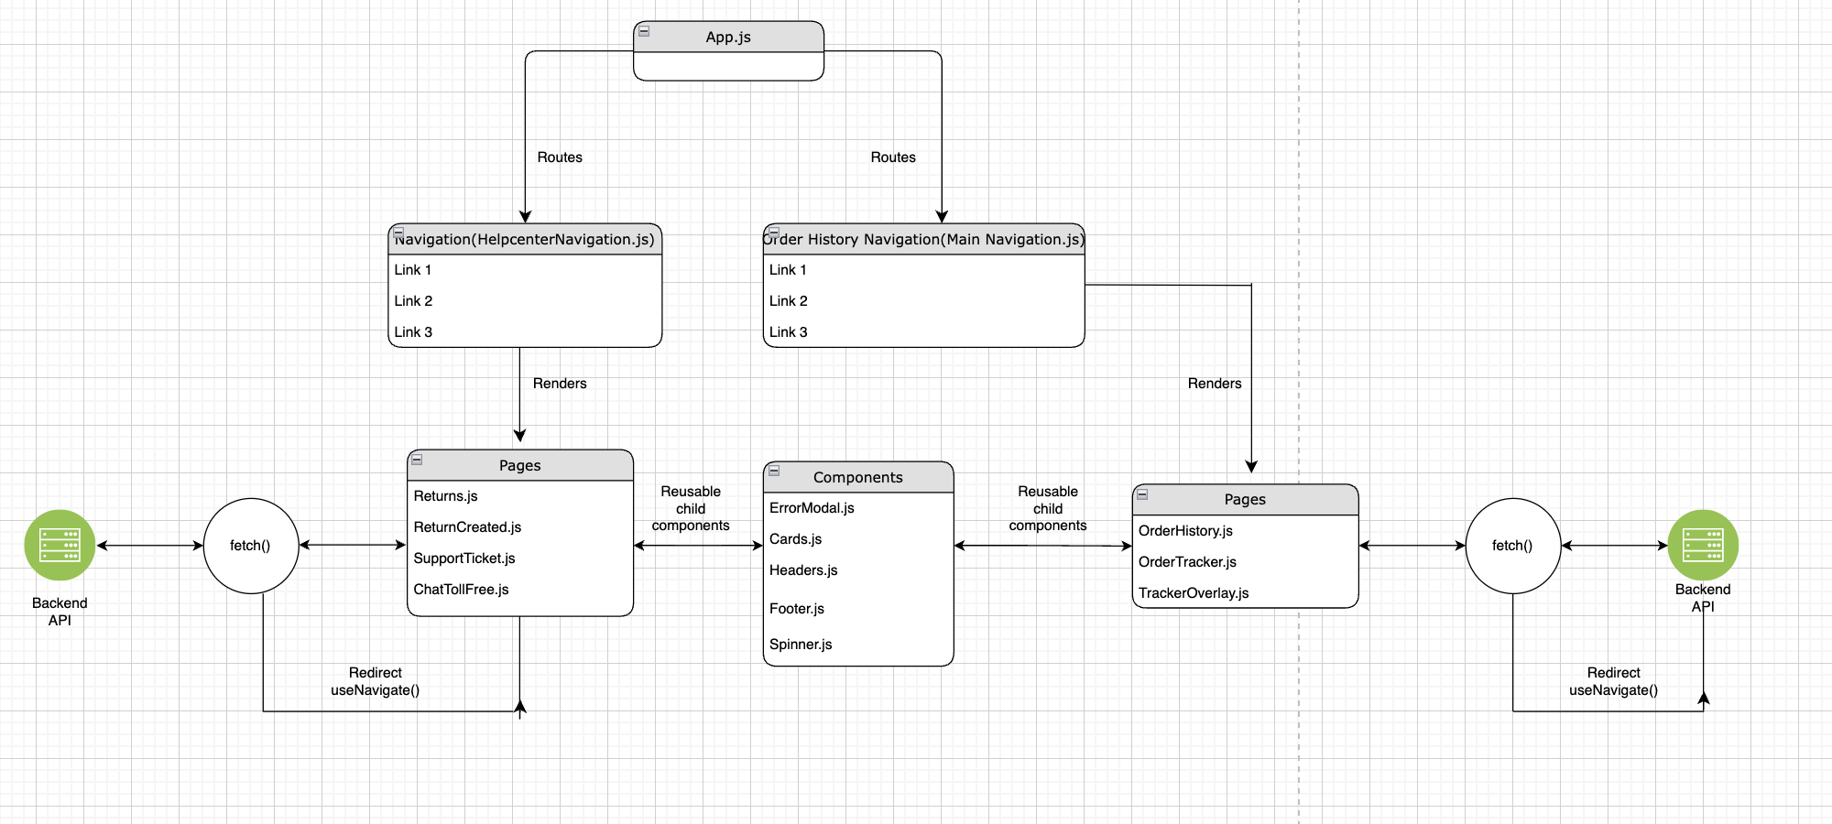
FE UI Flow

Slide 13
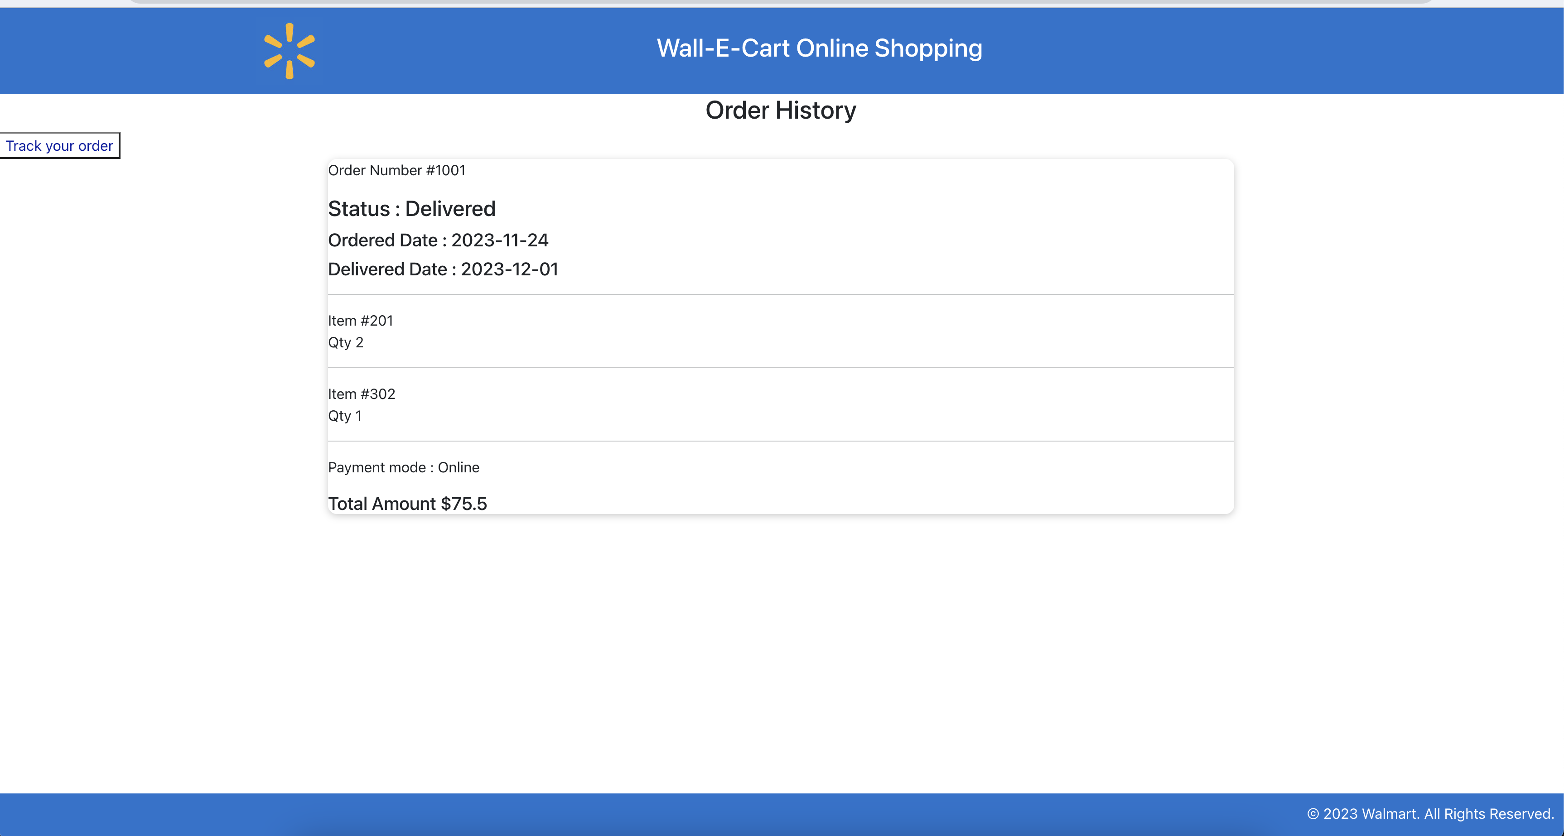
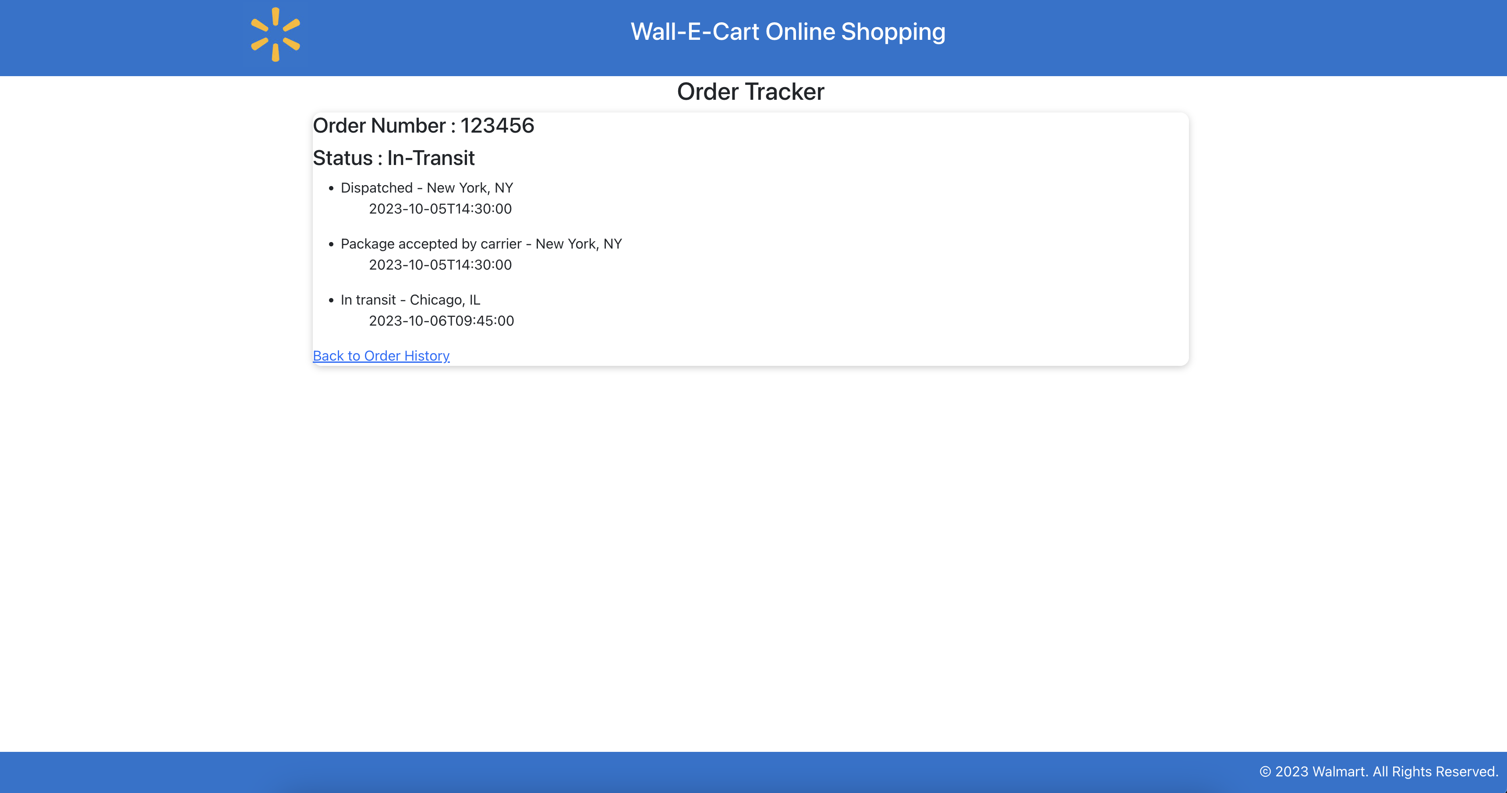
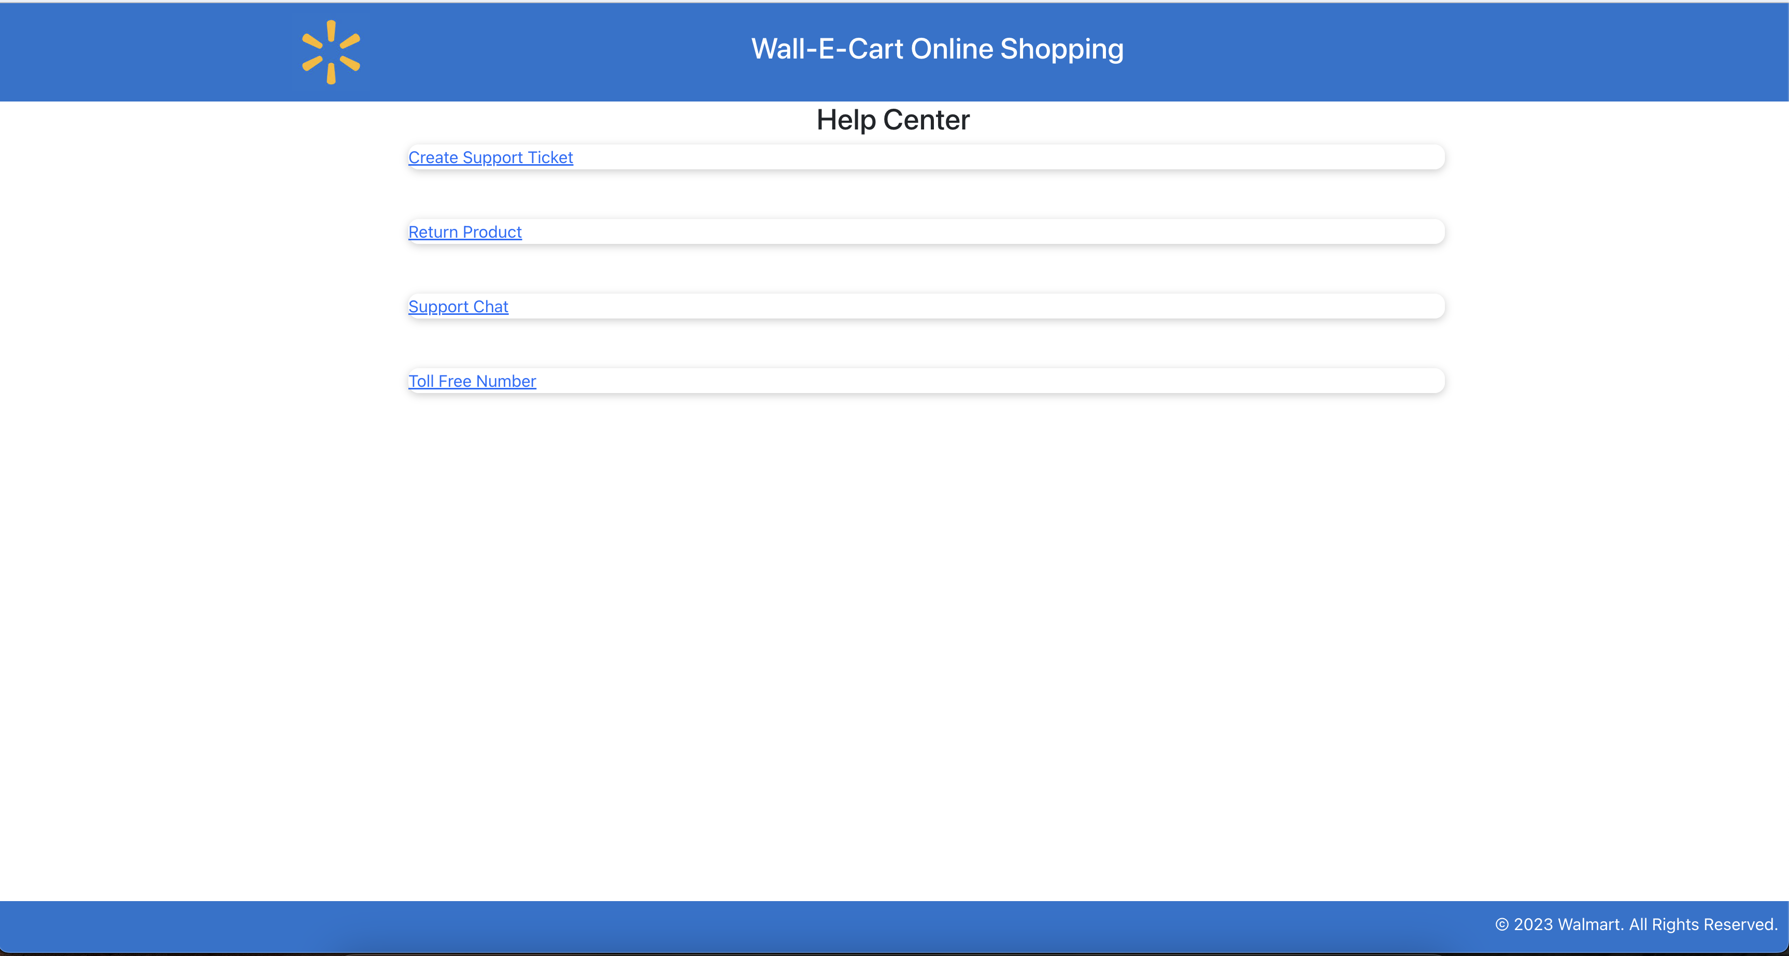
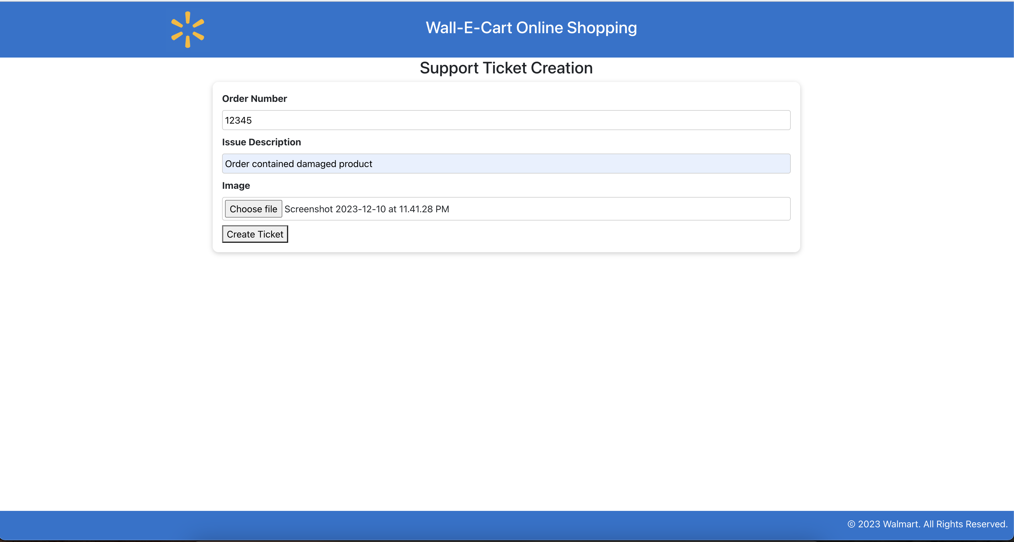
FE UI Screen Snippets

Slide 14
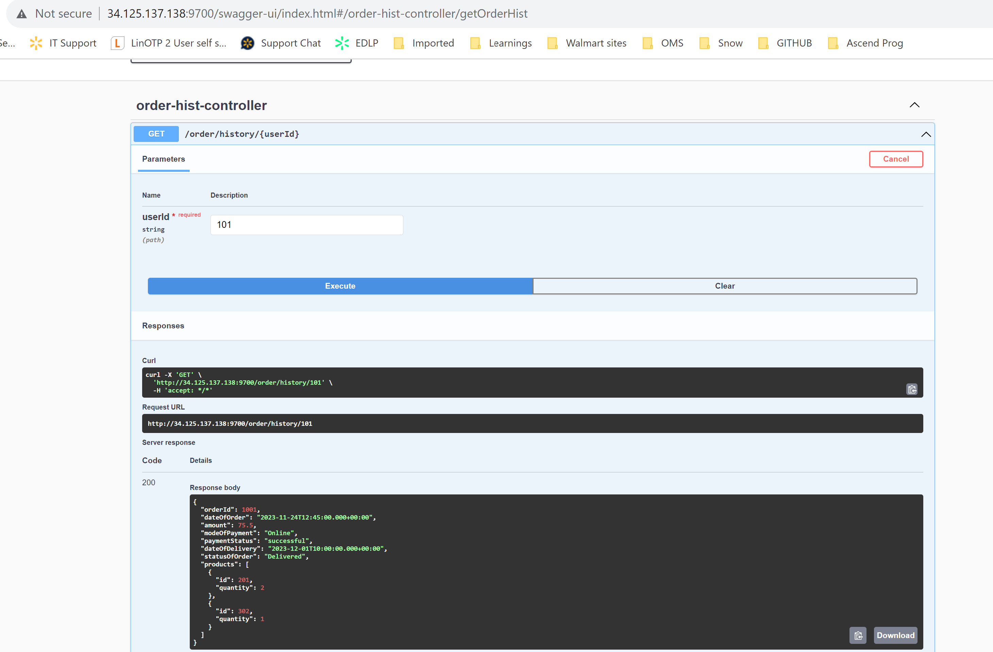
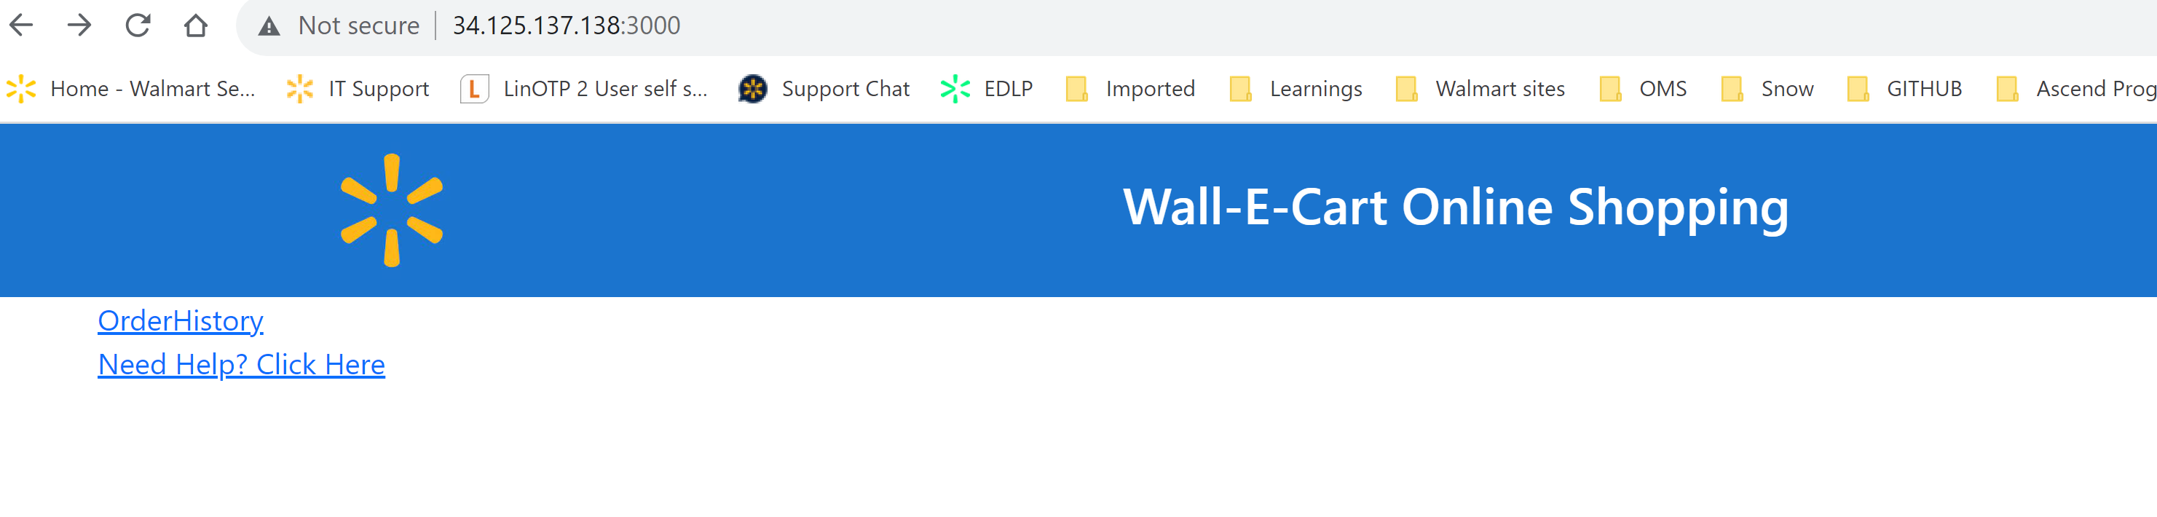
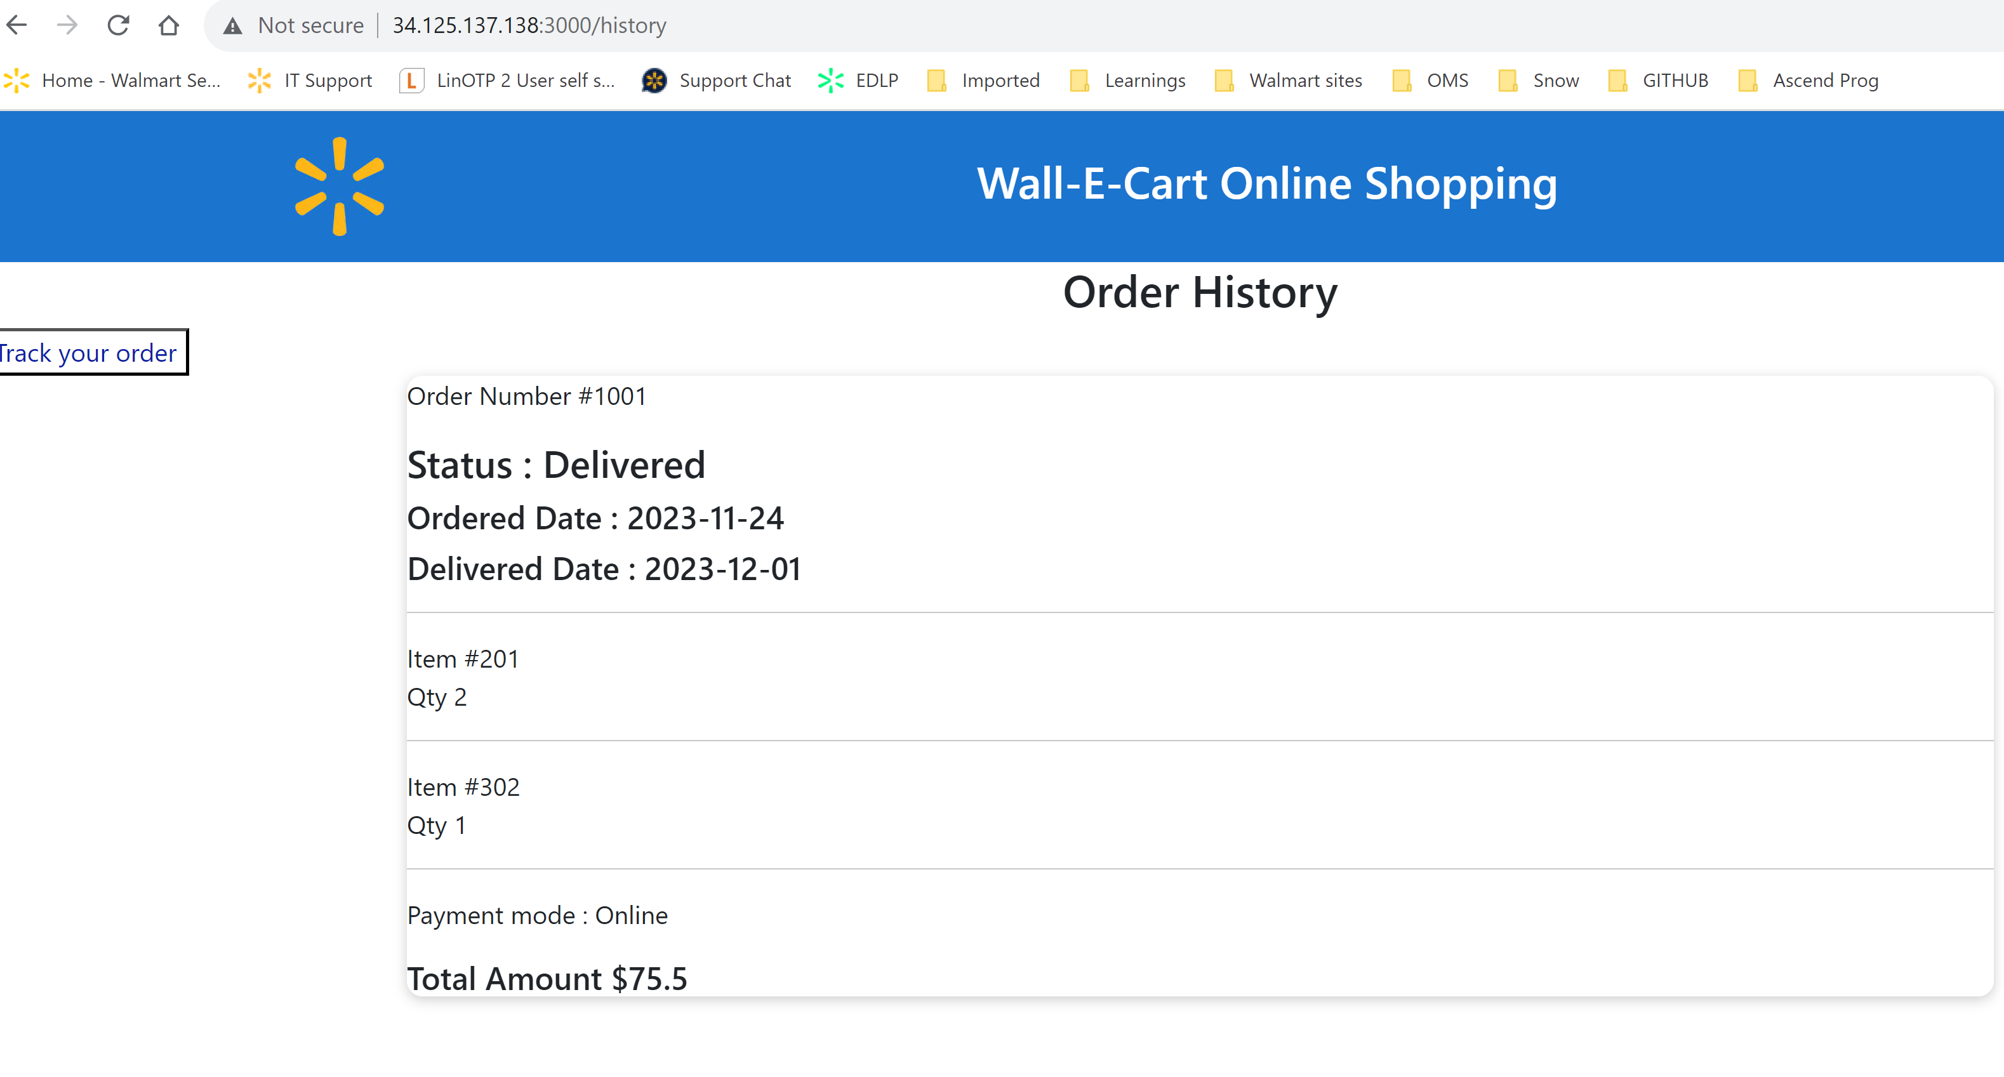
Order History API Integration with Front End and Swagger

Slide 15
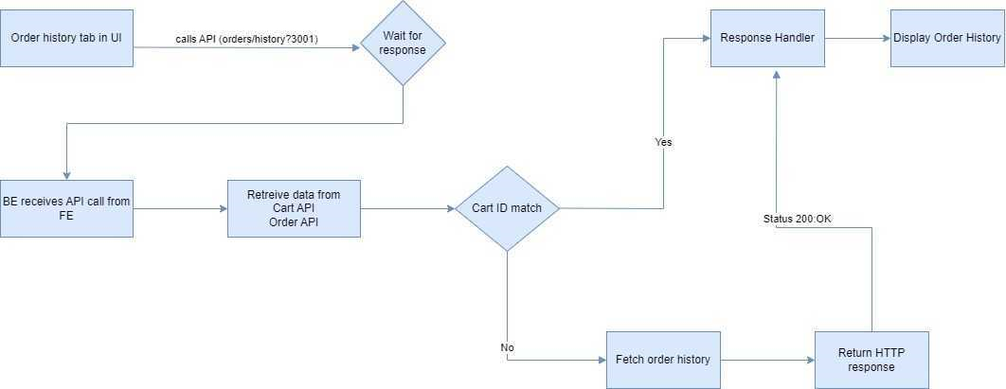
Order History Solution Design

Slide 16
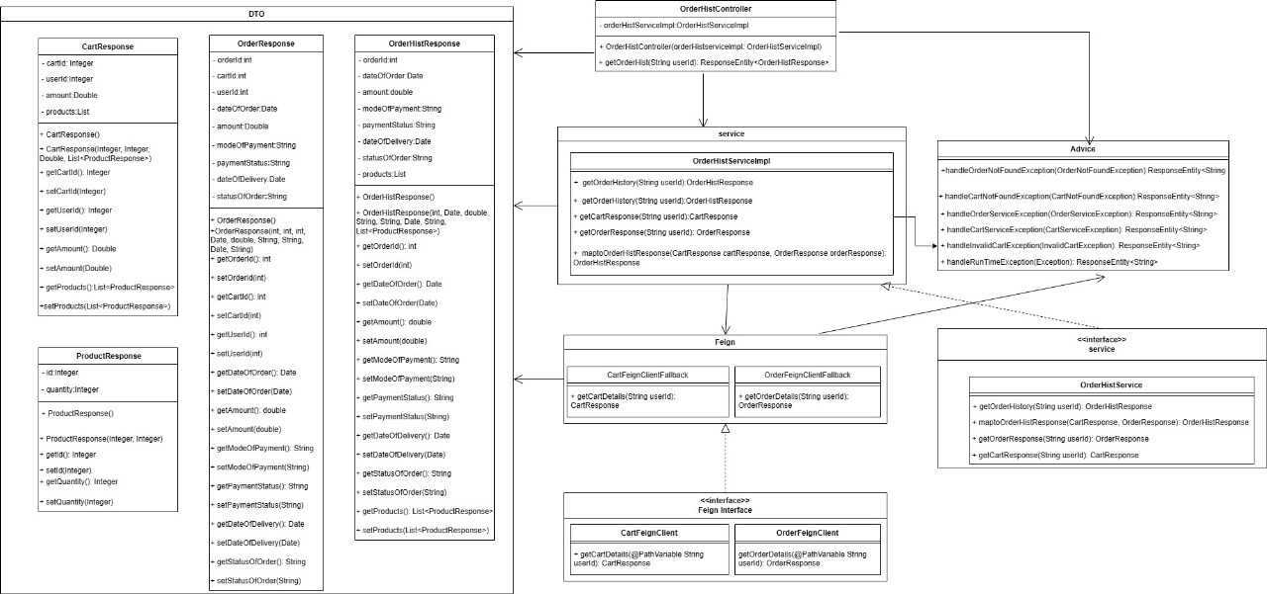
OrderHistory Class Diagram

Slide 17
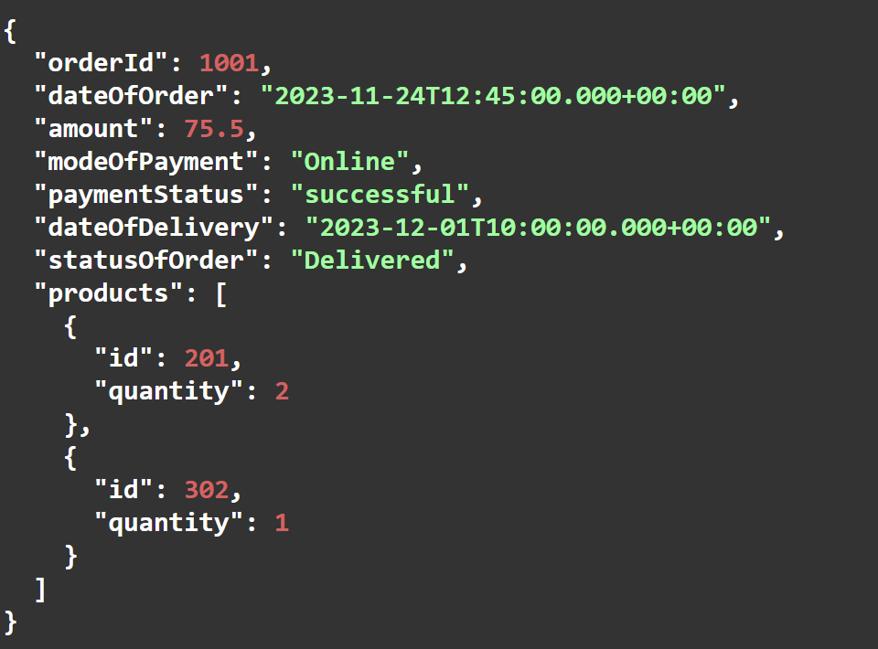
Order History API Contract
Failure Scenario
Success Scenario
User Defined Exception
CartNotFoundException:
OrderNotFoundException:
Fallback Mechanism
CartServiceException:
Generic Exception
Exception:
InvalidCartException:
Serves as a fallback for unhandled exceptions.
Returns a 500 Internal Server Error status with a generic error message.
Encourages users to refresh the page and notifies about an internal server error.
Handles instances where an order is not found.
Returns a 404 Not found status with a user-friendly error message.
Handles instances where a cart is not found.
Returns a 404 Not found status with a user-friendly error message.
Handles instances where a cart is invalid.
Returns a 404 Not Found status with a user-friendly error message.
OrderServiceException:
Handles exceptions related to the order service.
Returns a 400 Bad Request status with a user-friendly error message.
Handles exceptions related to the cart service.
Returns a 400 Bad Request status with a user-friendly error message.

Slide 18
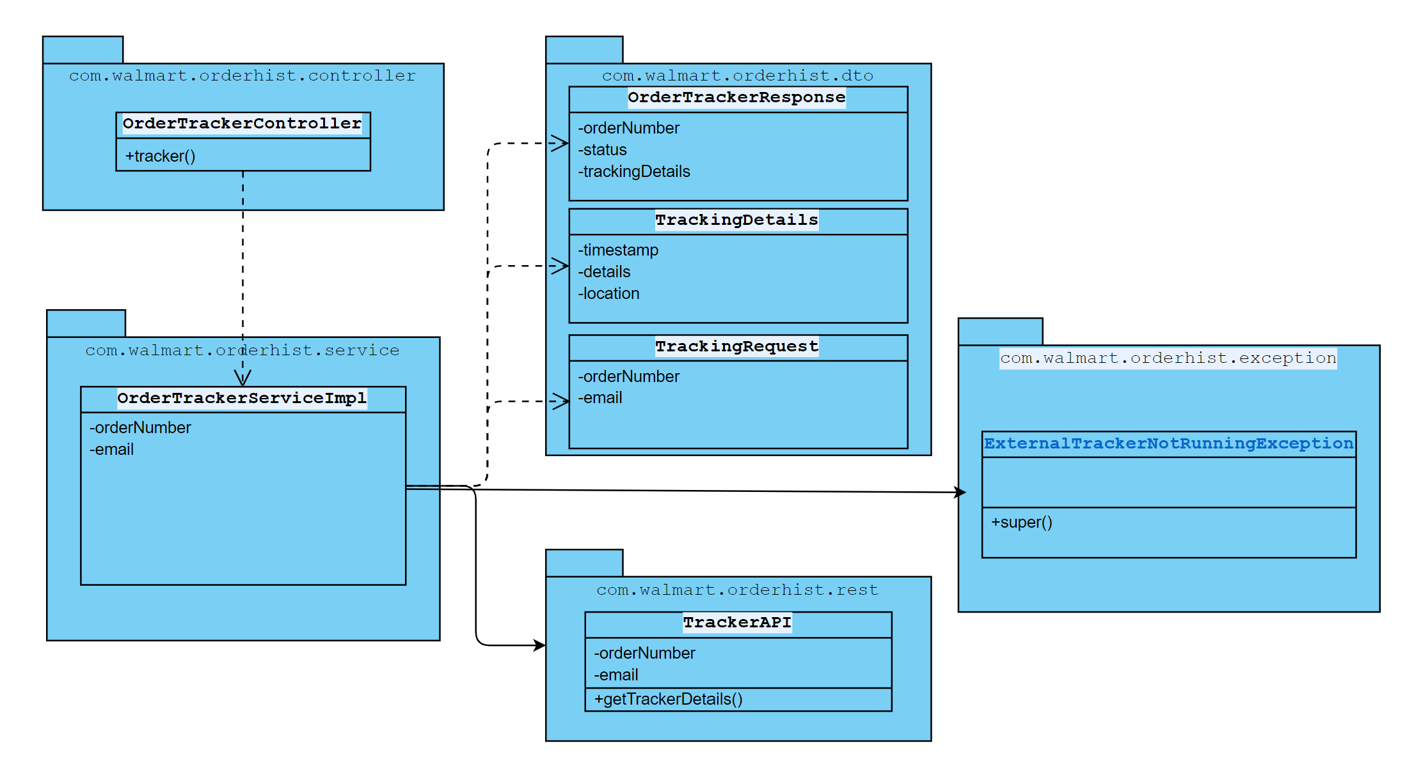
Order Tracker Class Diagram and Use case diagram

Slide 19
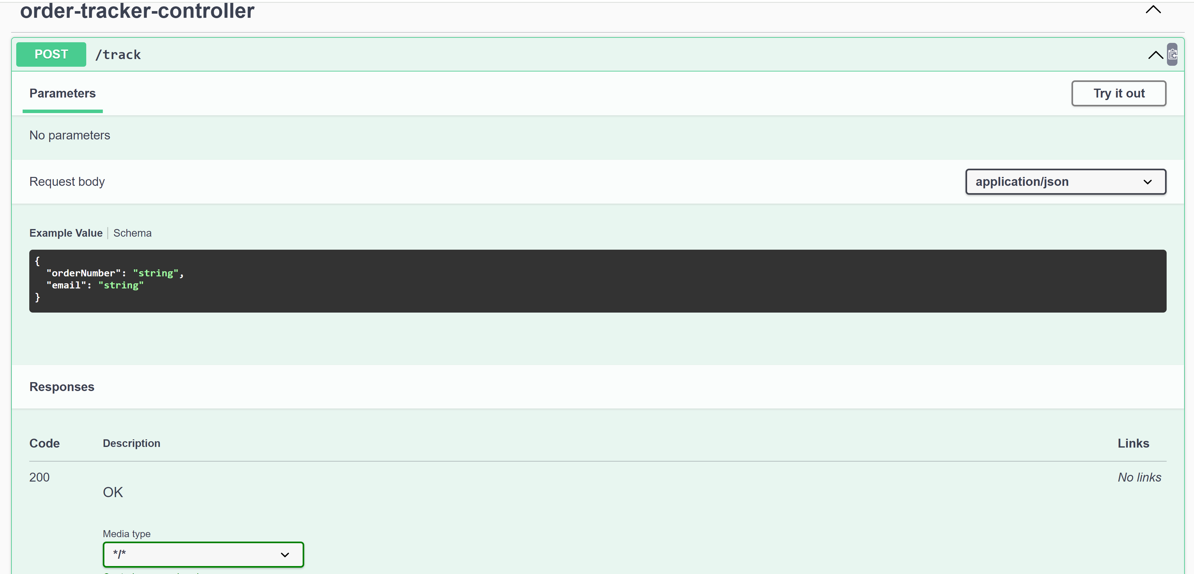
Order Tracker swagger

Slide 20
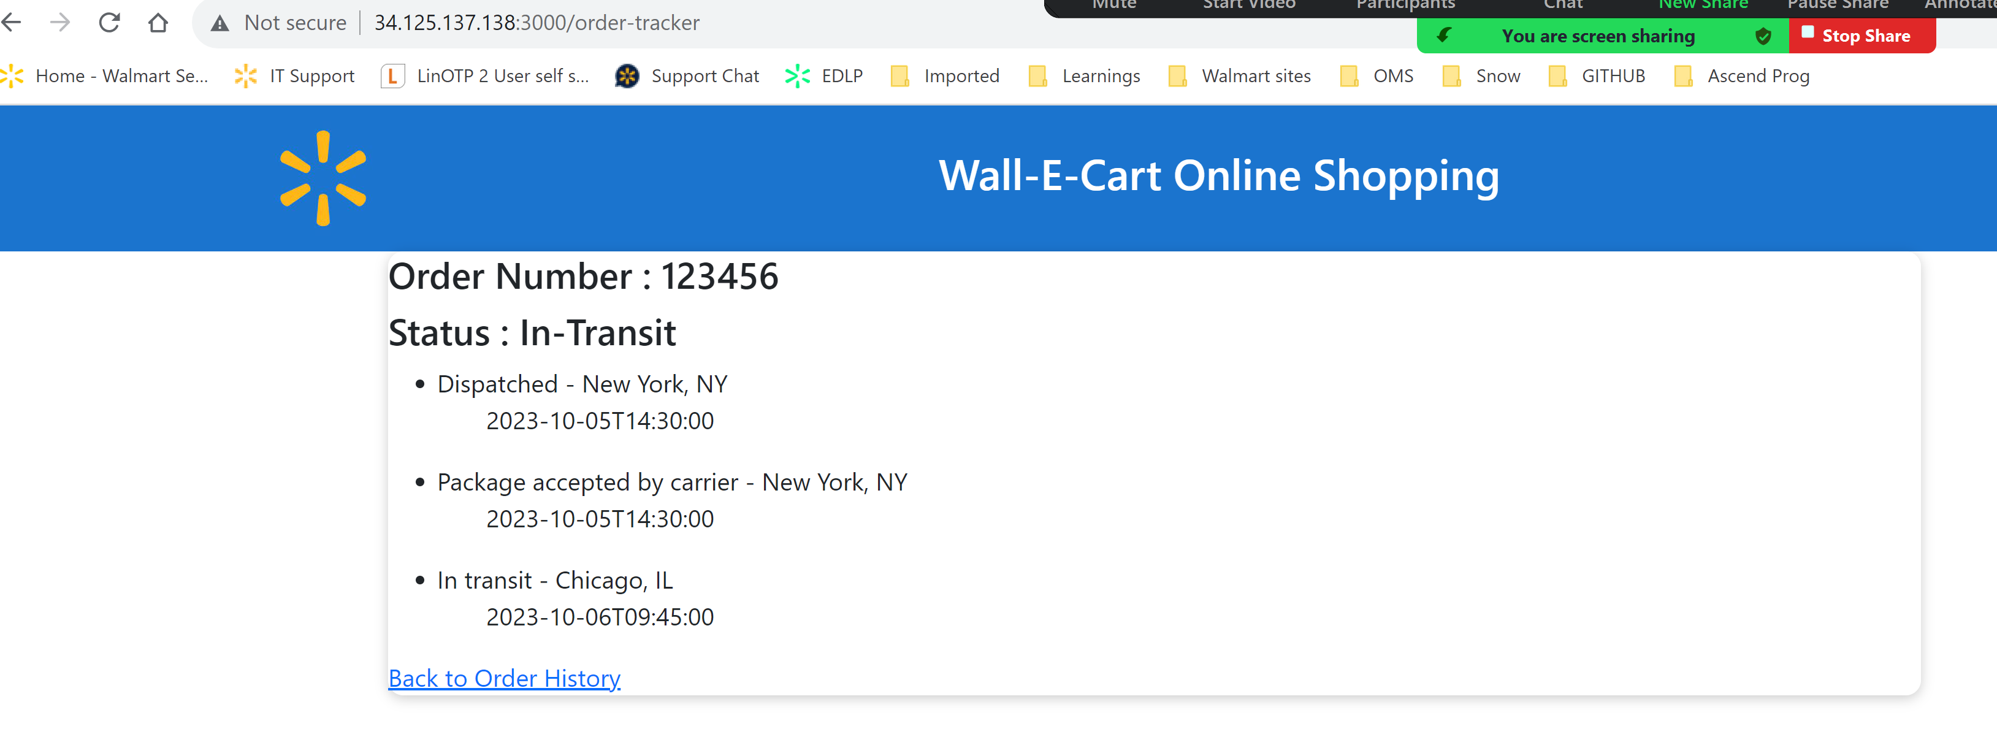
Order Tracker frontend

Slide 21
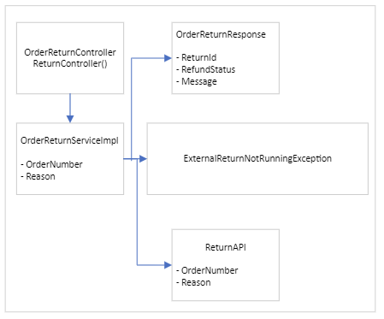
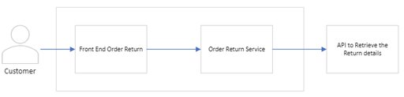
Order Return Class Diagram and use case diagram

Slide 22
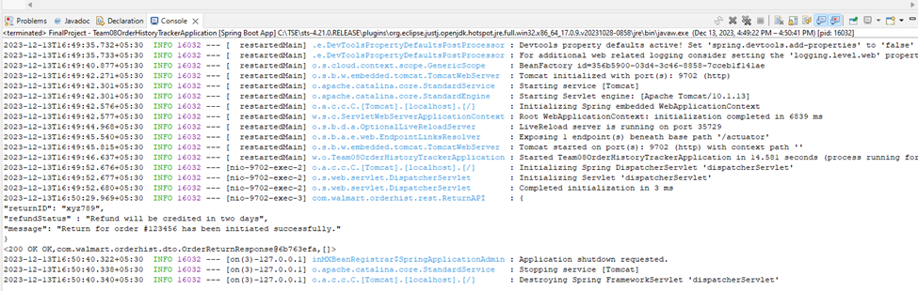
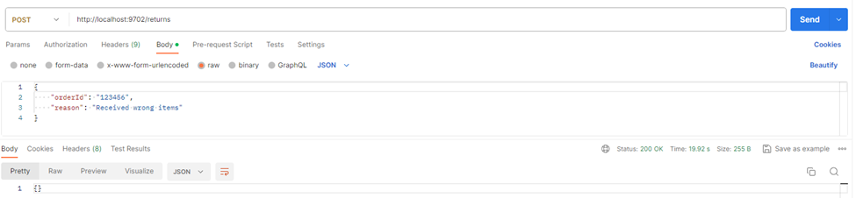
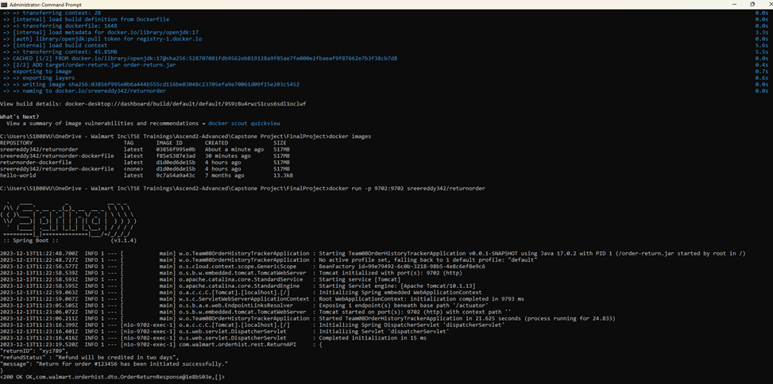
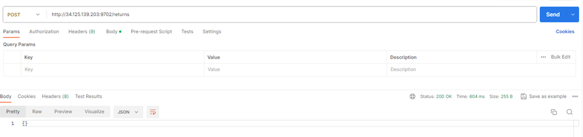
Output Results
Application output
Postman Execution results
Docker Image output
4. After deploying into cloud the execution results from postman

Slide 23
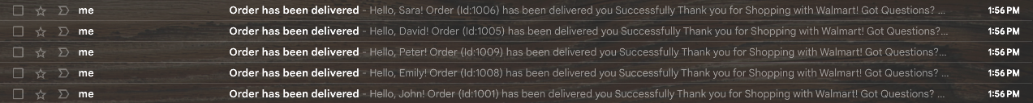
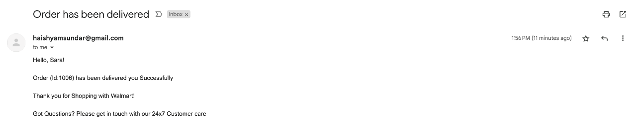
Order Notification Service
• Program will notify the user about the order status change (Order Placed, in-transit, Delivered) in the email notification
Sample Email:

Slide 24
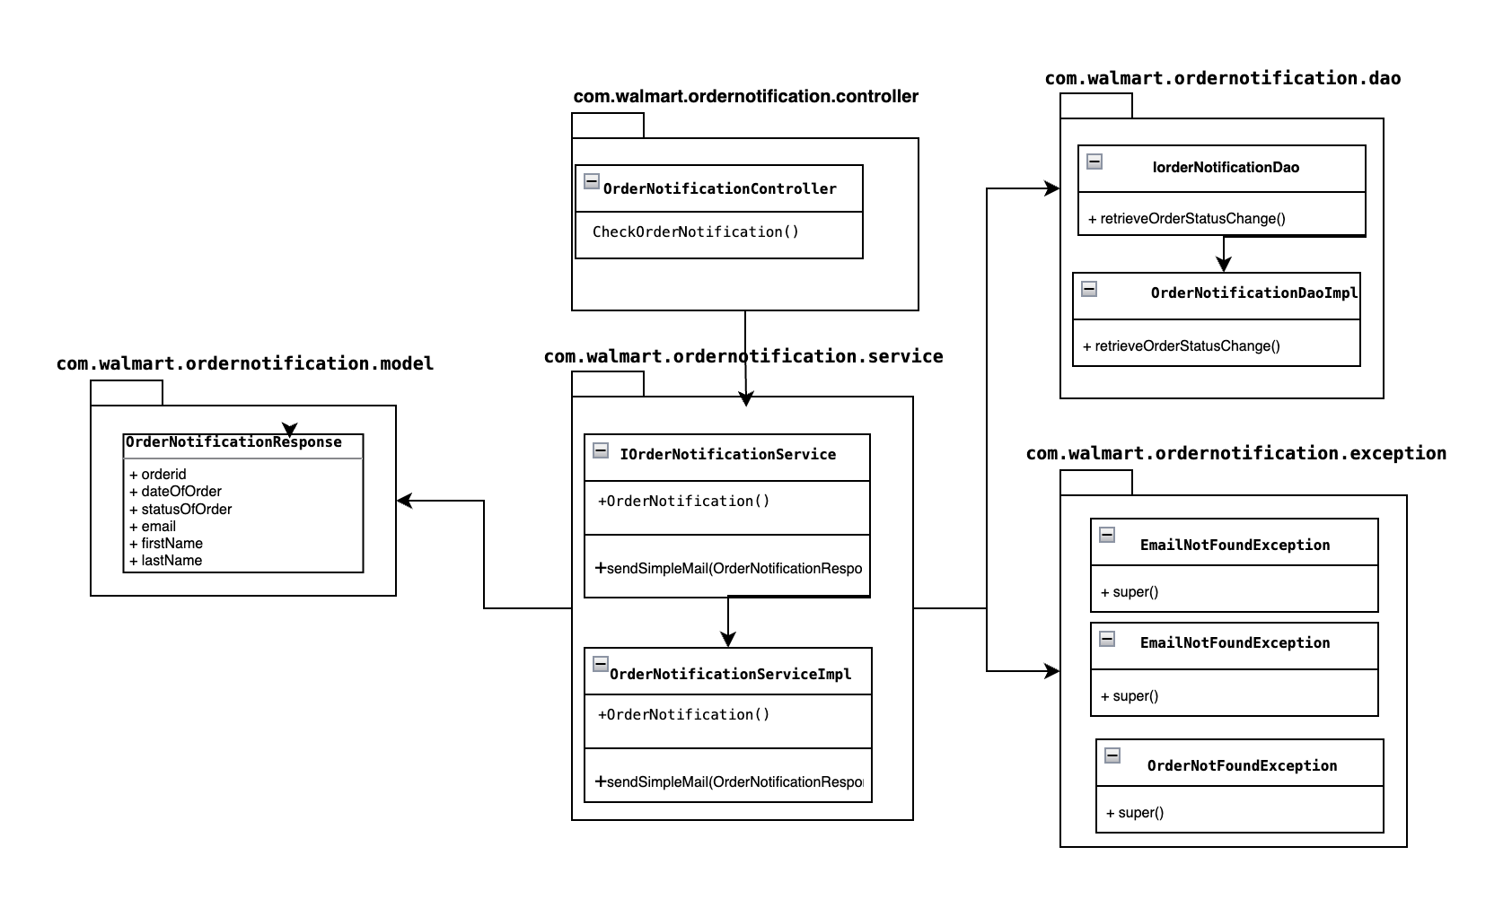
Order Notification Class Diagram

Slide 25
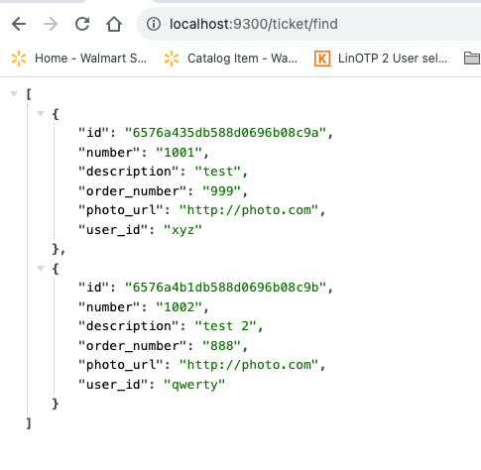
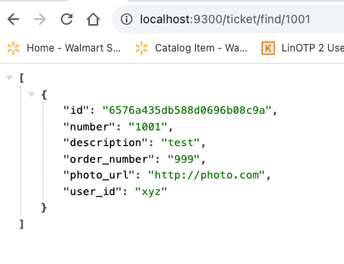
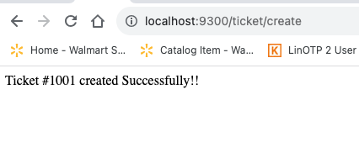
Support Ticket Service
• Program will create a Support ticket and provide a response. Program enables the user to check all the ticket he has created and get all details of the specific ticket
Sample Responses:

Slide 26
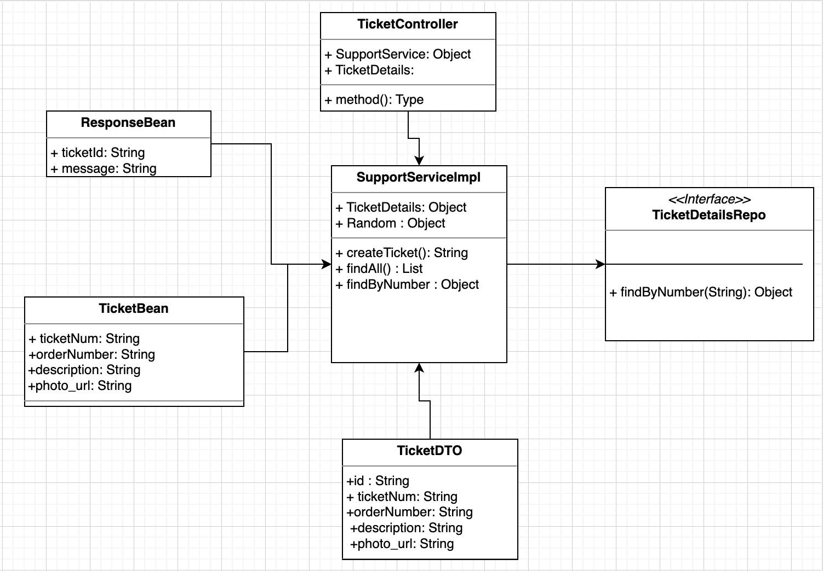
Support Ticket Service – Class Diagram

Slide 27
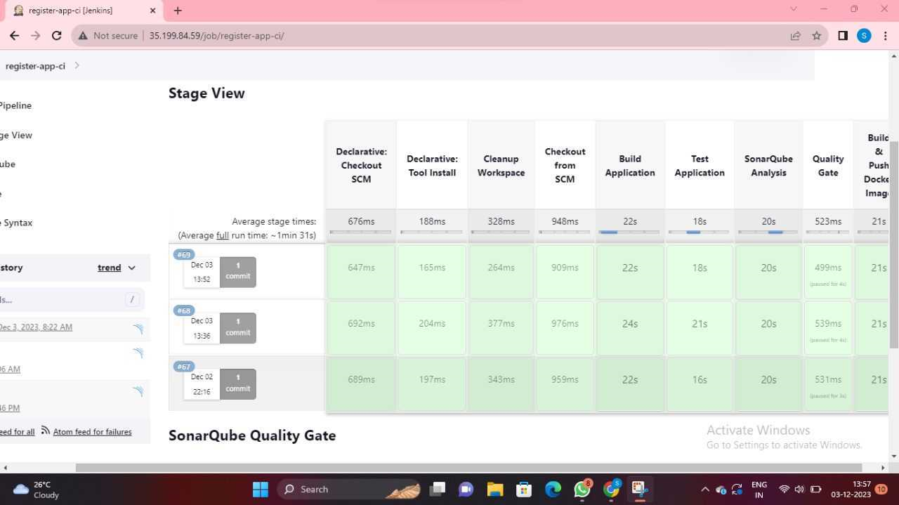
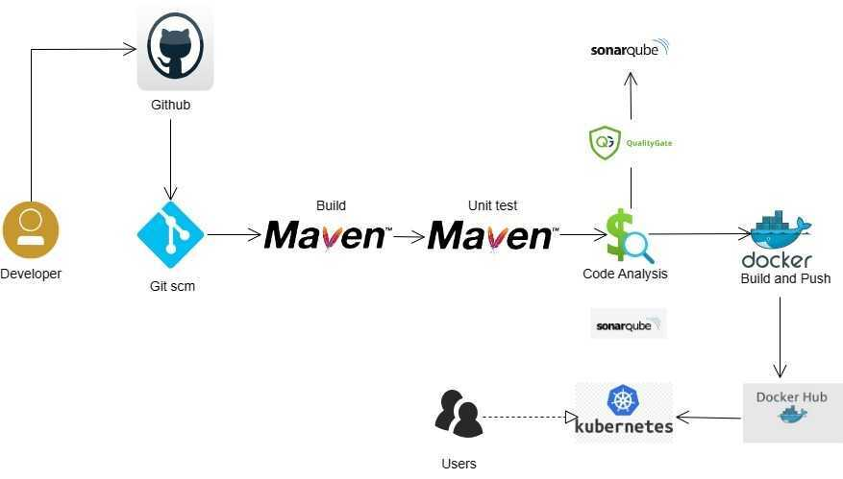
CICD pipeline Integration

Slide 28
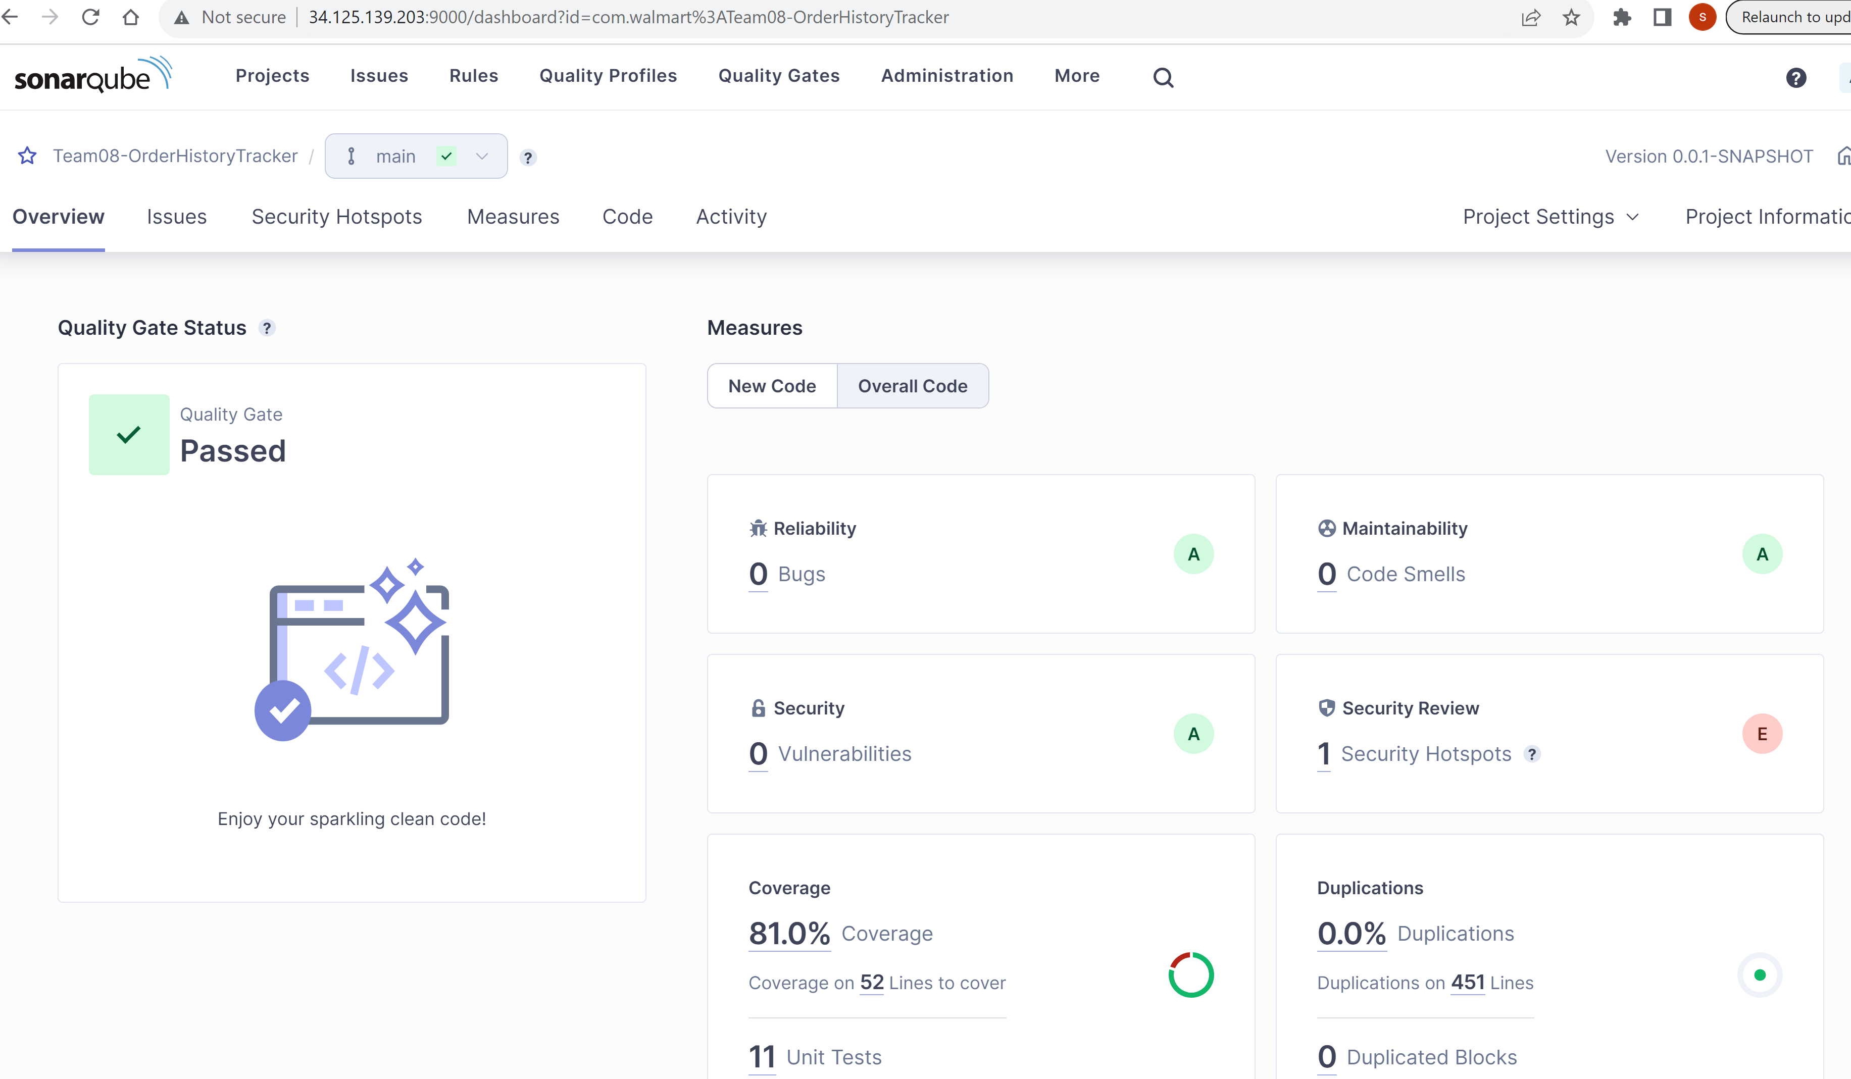
SonarQube Integration

Slide 29
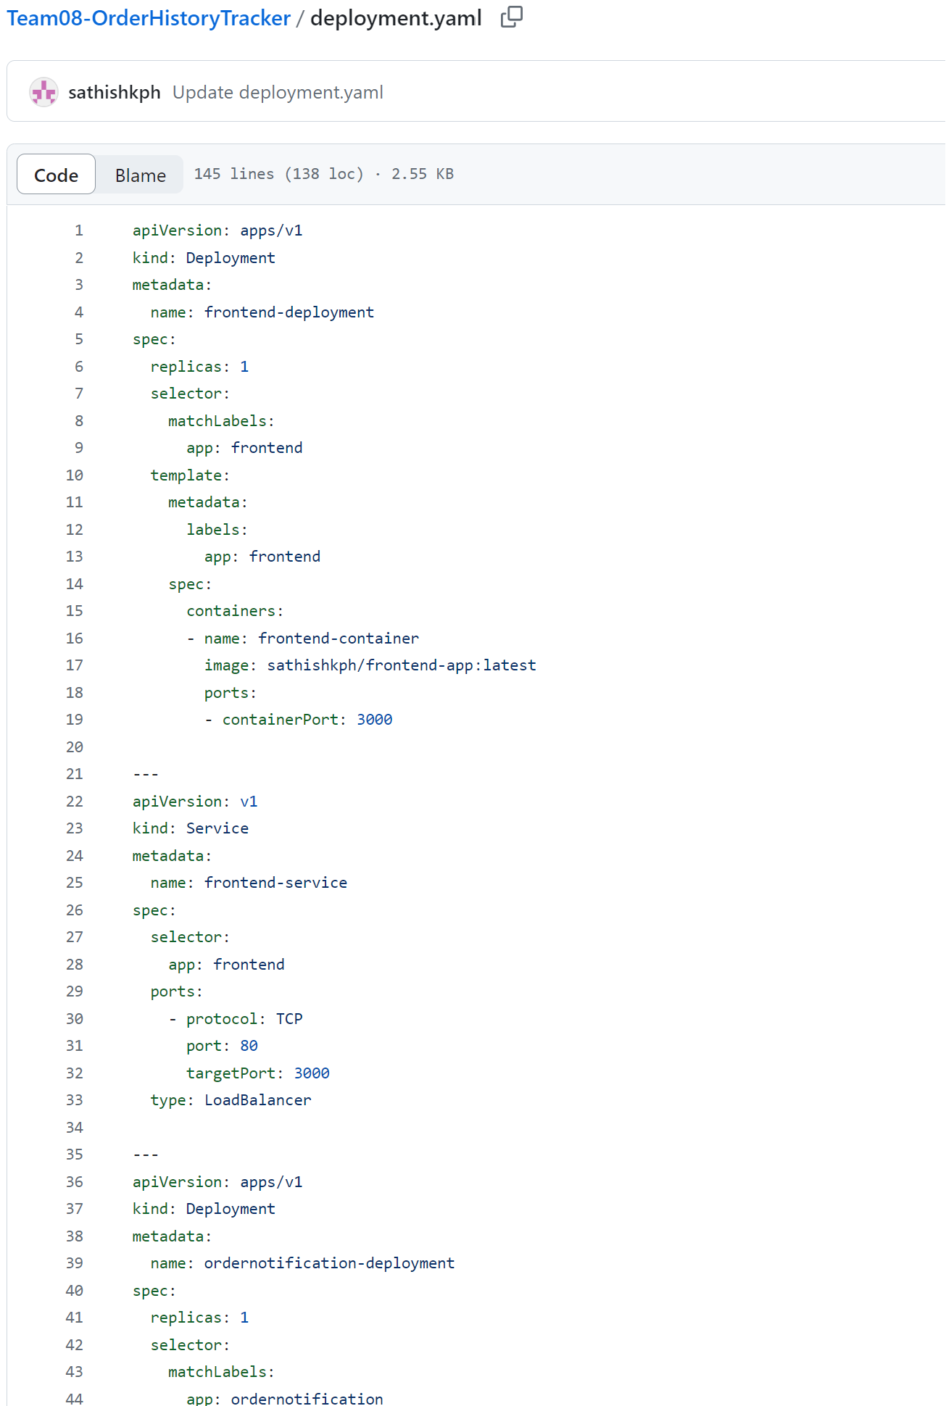
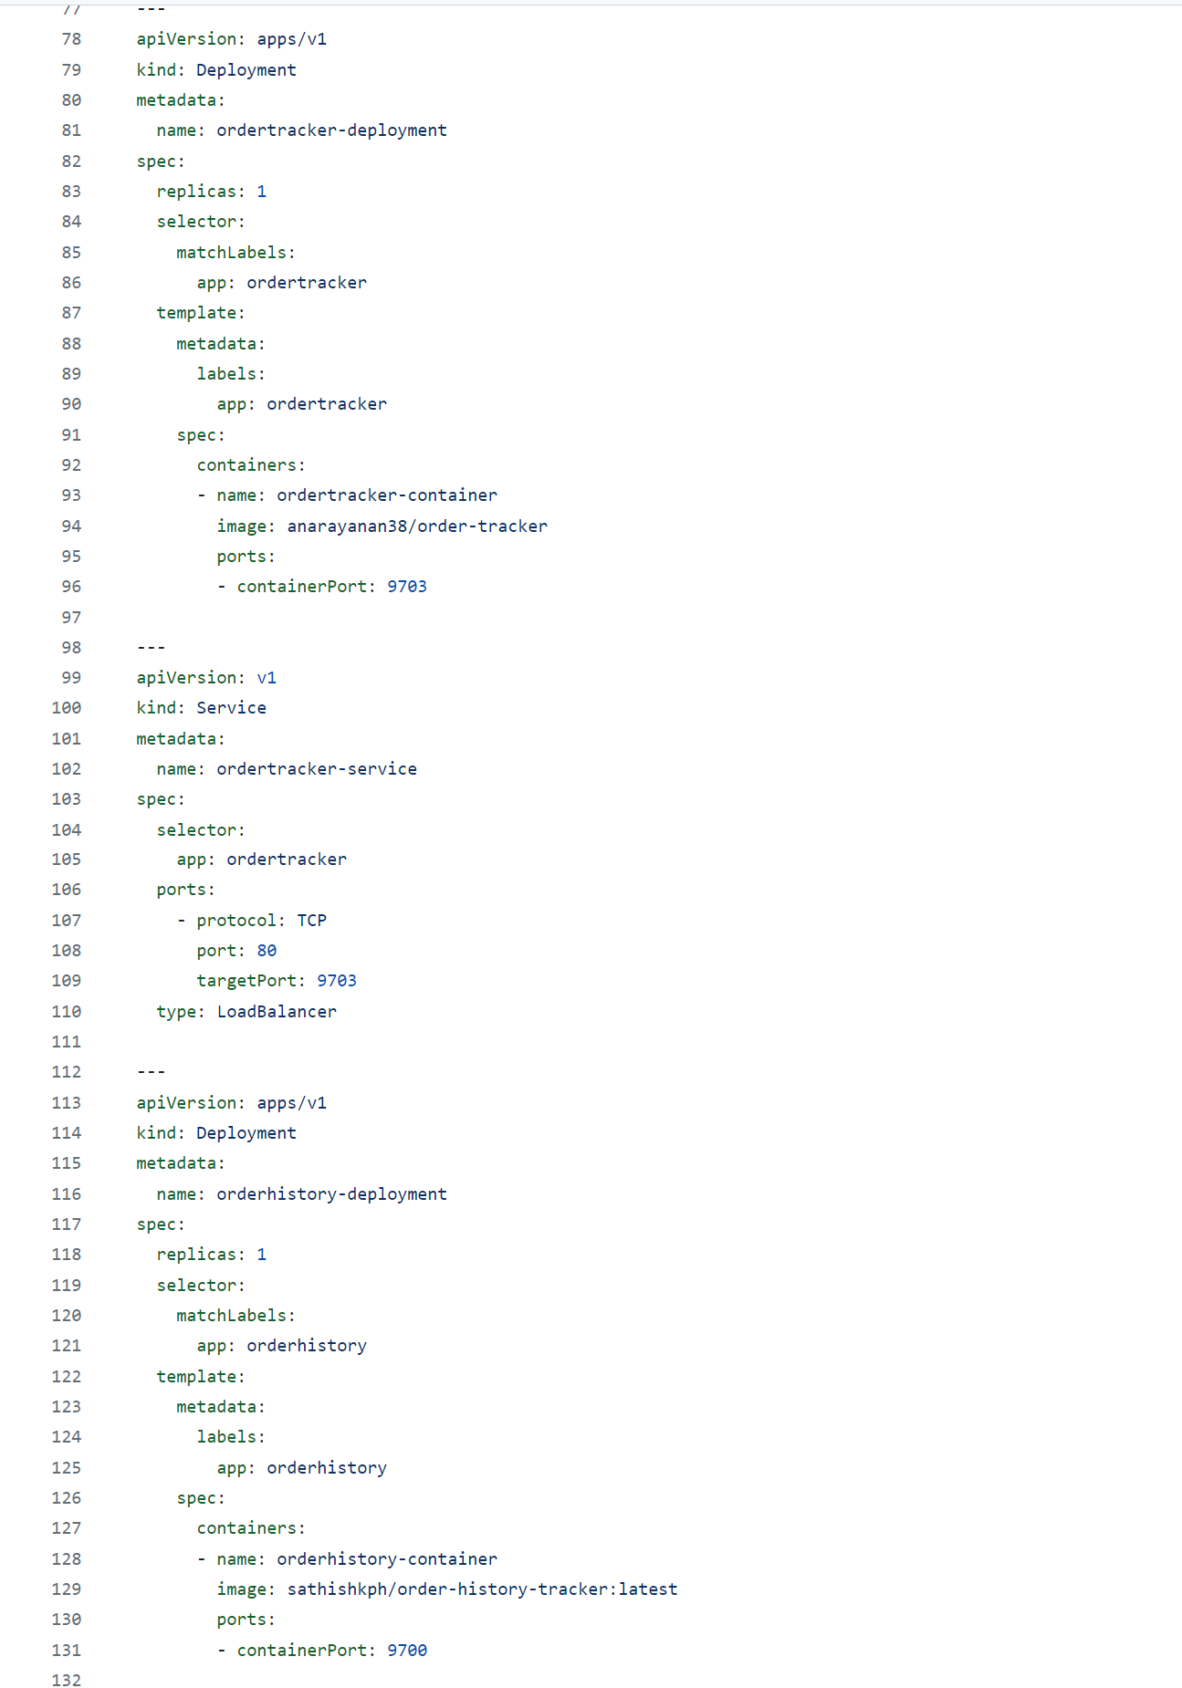
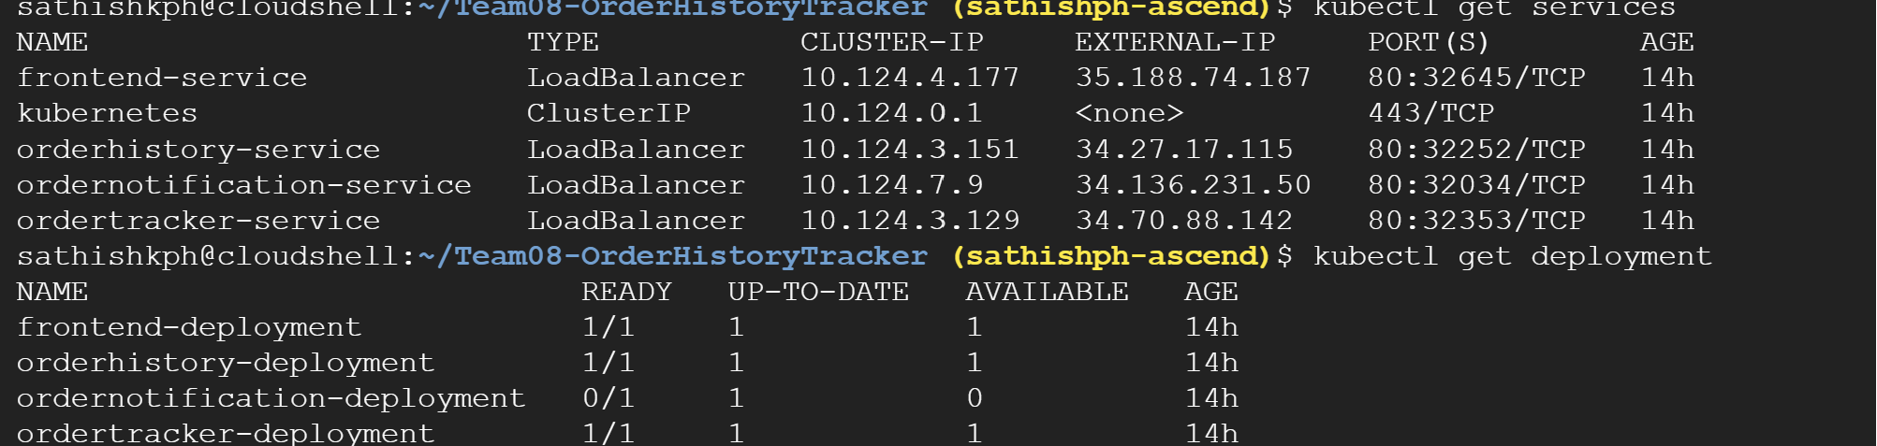
Kubernetes Deployment

Slide 30
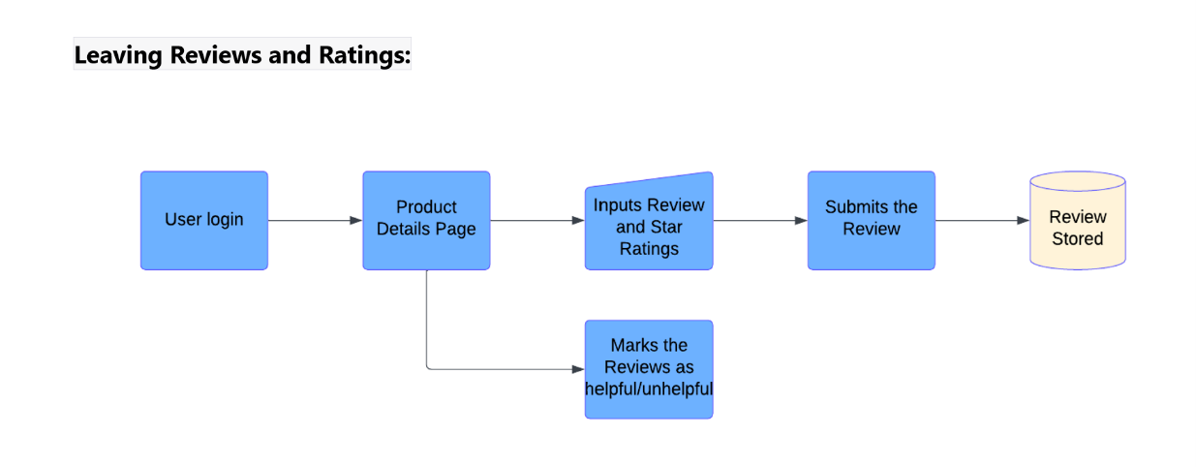
Capstone Project Solution Design
User will be able to share the feedback for the products that he has already purchased.
User should be authenticated to comment or review.
User should be able to view the updated list of product review.
Every user comment will be validated by storing in temp DB before updating it in the main DB.
Admin will validate the reviews manually and then approve to update in main DB.

Slide 31
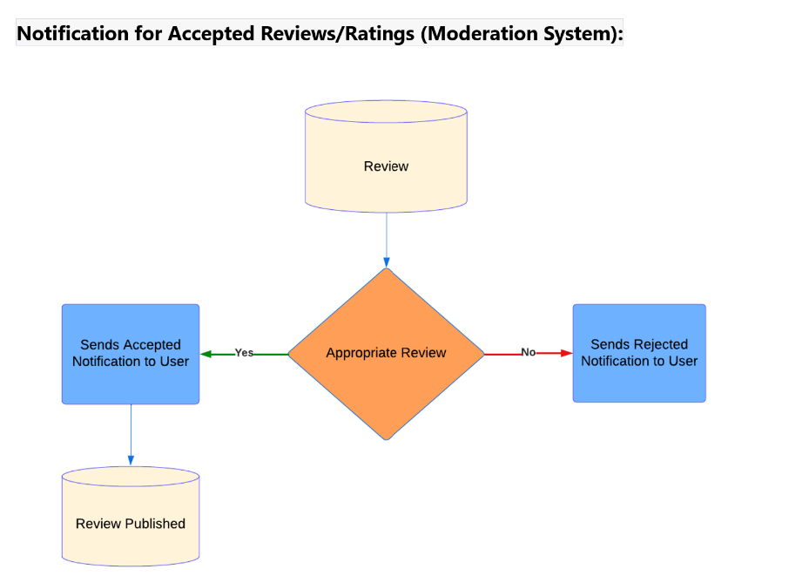
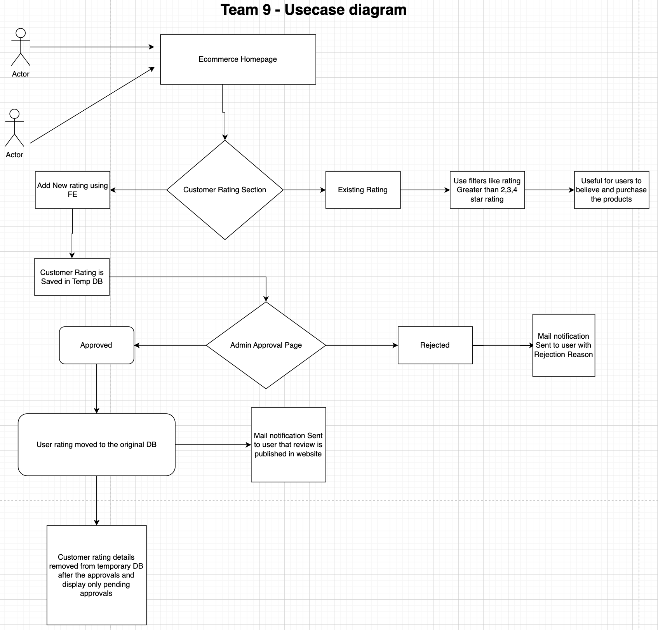
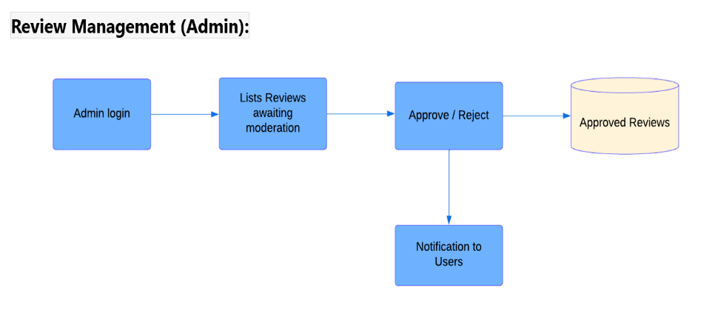
Capstone Project Solution Design
Use case diagram

Slide 32



Capstone Project Solution Implementation [BACKEND]
User Login is identified using the the active session cookie present in the browser.
User reviews & ratings are stored in temporary DB collection for validation.
When rating comment is approved, delete from temp DB and update in the original product DB
User has an option to update his review until it is approved and published.
Controller Sample

Slide 33



Capstone Project Solution Implementation [BACKEND]
Key Requirement of adding a new rating and view the existing rating of a product(Product DB dataset).
Users can view reviews and add star ratings by providing in range of 1 to 5 along with a comment
Postman output
Logics

Slide 34



Capstone Project Solution Implementation [BACKEND]
Exception Handling:
Handled exceptions for use cases where the entered product code is not available, displaying the error message "No product found.“
Managed exceptions for situations where the entered rating is not available, presenting the error message "No rating found.“
If there is no approval status, the system communicates that the "Review is not yet approved.“

Slide 35



Capstone Project Solution Implementation [BACKEND]
Addressed scenarios where a user attempts to post a review without providing an email ID, resulting in an exception labeled "No user details found.“
When both email ID and approval status are provided, the review is published in main DB, and a notification is sent to the user confirming the successful posting.
New reviews are initially stored in a temporary database, and upon approval, they are transferred to a permanent database, subsequently being deleted from the temporary database.

Slide 36


Capstone Project Solution Implementation [BACKEND]
Enhanced security by not directly exposing MongoDB credentials in the URI; instead, credentials are passed securely through environment variables.
Converted the Spring Boot application into a Docker image, making it globally accessible by hosting it on Docker Hub. Image: https://hub.docker.com/r/danicoolbug/cusreviewhub

Slide 37



Capstone Project Solution Implementation [BACKEND]
Implemented 12 JUnit testing for both new and approved comments to ensure robust testing practices.
Implemented slf4j logger functionality and directed logs to a separate file and actuator for monitoring services for effective troubleshooting in case of issues.

Slide 38


Capstone Project Solution Implementation [BACKEND]
Used SonarLint tool to detect bugs, code smells and security vulnerabilities
Scenario 1: Persistent entities should not be used as arguments of "@RequestMapping" methods.
By accepting persistent entities as method arguments, the application allows clients to manipulate the object’s properties directly.
So, the Attackers could forge malicious HTTP requests that will alter unexpected properties of persistent objects. This can lead to unauthorized modifications of the entity’s state.

Slide 39


Capstone Project Solution Implementation [BACKEND]
Scenario 2: MongoDB database passwords should not be disclosed.
Secret leaks often occur when a sensitive piece of authentication data is stored with the source code of an application.
Considering the source code is intended to be deployed across multiple assets, including source code repositories or application hosting servers, the secrets might get exposed to an unintended audience.
So, We have passed credentials securely through environment variables.

Slide 40




Capstone Project Solution Implementation [BACKEND]
Integrated CICD pipeline with GitWorkflow for streamlined processes, including testing, creating Docker images, and updating new versions in Docker Hub
Using AppMap tool(runtime code analysis tool) in IntelliJ IDEA, we are able to generate dependency map, Sequence diagram, flame graph for each use case in springboot project.

Slide 41


Capstone Project Solution Implementation [FrontEnd]
Front End page provides user the option to add new Star Rating for the purchased product.
User can enter the product review in the comment section to share their experience.
Retrieve images from Product DB to display in page
User review is subjected to validation by Admins
If approved, user comment is added to main DB & entry deleted from the temporary DB.
If rejected, user is notified though email.

Slide 42



Capstone Project Solution Implementation [FrontEnd]
Routing Logics Technology for switching between different UI views, based on the changes of the current URL.
Front end Logics

Slide 43



Frontend Response
3.After Approved/Rejected
2.Pending approval
4.Notification once approved
1.Notification while under review

Slide 44


Authentication
During the below flow only authenticated user can add rating and product review.
User with session expired or non-authenticated user will be redirected to the login screen.
Validation is performed using the Session Token generated by Auth team
FE will add user-id-email header only for Authenticated user which is one of key criteria to add a review.
Team1 API: http://52.142.30.237:9003/api/auth/signin

Slide 45


Authorization
Admin of the application will be able to moderate the given review to check of vulnerable contents manually.
Only Users will admin roles can login and not regular users.
Until Admin approved the customer rating, it stays only in temporary DB
When admin approves customer rating is added to original product DB and deletes the entry in Temp DB.
If Admin Rejected/approves user is notified through email about the each progress.
API: http://52.142.30.237:9003/api/test/role

Slide 46
Best Practice in Development
Version Control:
Utilize Git for tracking changes, collaboration, and code history management.
Employ branching for new features and bug fixes, utilizing pull requests for code reviews.
CI/CD Integration:
Implement CI/CD pipelines to automate build, test, and deployment processes.
Embrace frequent code deployment to minimize integration issues.
Code Quality and Testing:
Integrate SonarQube for continuous code quality inspection.
Address issues identified by SonarQube to maintain high code standards.
Write comprehensive test cases to ensure functional and non-functional requirements.
Regularly execute test suites as part of the CI/CD pipeline.
Error Handling:
Establish robust error-handling mechanisms for meaningful error messages.
Log errors systematically for analysis and debugging insights.
Collaboration and Communication:
Foster a collaborative environment with open communication channels.
Utilize collaboration tools and conduct regular meetings to keep the team aligned.
Kubernetes Implementation:
Leverage Kubernetes for container orchestration and scalable deployment.
Enhance application resilience, scalability, and maintainability.

Slide 47
Learnings & enhancements – Team9
User Engagement:
Learning: analyse user engagement with the rating and feedback features.
Enhancement: Implement analytics to track user interactions, identify patterns, and gain insights into user behaviour.
Feedback Analysis:
Learning: Review and analyse the feedback provided by customers.
Enhancement: Incorporate sentiment analysis tools(eg. Google Cloud Natural Language API) to automatically classify feedback into positive, negative, or neutral sentiments.
Security Concerns:
Learning: security measures taken to protecting customer data.
Enhancement: Implement secure coding practices, encryption for sensitive data, and regular security audits to identify and address vulnerabilities.

Slide 48
Challenges & Learnings
Encountered challenges integrating frontend and backend code.
Learned about Cross-Origin Resource Sharing (CORS) to enable backend code access.
Delved into Nginx and Kubernetes for efficient microservice deployment. Gained insights into developing a comprehensive application through microservice integration.
Dealt with server port contract complexities while interacting with other microservices. Learned about CICD pipeline Integration.
Faced challenges in maintaining API request and response contracts. Acquired skills to deploy the application in a cloud environment.

Slide 49

Challenges & errors encountered during solution design- Team9
Dependencies
User Authentication Team1
As the FQDN name is different for auth and Customer rating the session token saved in browser cookie is not passed for subsequent connections. If the FQDN is common, then we could use the session token to validate the user directly.
2. Product Review Write a new review as comment using our URI
Only Purchased user can write a product comment
3.Email notification is being sent to user at each stage so that the user is aware.
4. Front end integration with backend was very challenging and has been partially completed to add the new
Rating and Admin approval page.

Slide 50
What extra can be implemented in the Capstone Project – Team9
Review Images and Videos: Enable users to attach images or videos to their reviews to provide a visual aspect of their experience with the product.
Gamification for Feedback: Introduce gamification elements to encourage customers to provide feedback, such as badges, rewards, or loyalty points
Performance Monitoring Implement continuous performance monitoring to quickly identify and address any degradation in system performance
Push logs to Splunk Cloud In general, we save the output and transaction events and errors in a log file but we tried integrating with splunk cloud but due to lack of time we are still stuck.

Slide 51












Tech Stack Used
Frontend Backend DevOps Deployment

Slide 52
Additional Project Features implemented
Microservices Deployment:
Deployed microservices in Kubernetes on Google Cloud Platform (GCP).
Leveraged Nginx as the cloud gateway for enhanced scalability and security.
Efficient CICD Pipeline:
Established a Continuous Integration and Continuous Deployment (CICD) pipeline.
Aims to reduce development time and ensure error-free deployments.
Code Quality Assurance:
Integrated with SonarQube for comprehensive code analysis.
Implemented a Quality Gate to ensure only high-quality code is deployed.

Slide 53
Reference
Git: https://github.com/walmart-2023-sep-ascend/Team08-OrderHistoryTracker
https://github.com/walmart-2023-sep-ascend/Team08-OrderNotification
https://github.com/walmart-2023-sep-ascend/Team08-OrderSupport-Return/tree/OrderReturn-Updated
CICD Pipeline: http://34.125.137.138:8000/
SonarQube: http://34.125.137.138:9000/projects
Test Results:
Application log
Test Results
Document

Slide 54


